Slide 1
ADvantage Azure
Intelligent Assistant
Pre-Built Avatars

Slide 2
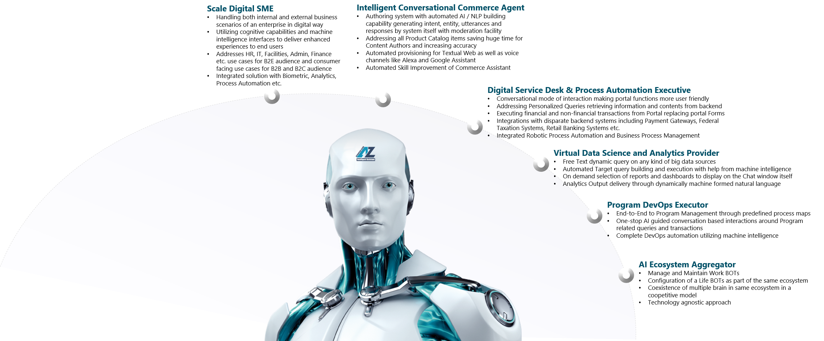
Business Avatars
Pre-built Full Functional Industry agnostic Intelligent Business Utilities

Slide 3
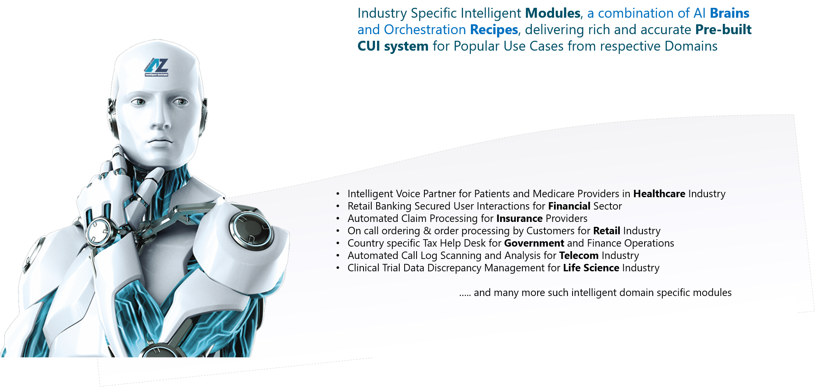
Industry Avatars
Pre-built Reusable Industry specific Intelligence Factory

Slide 4
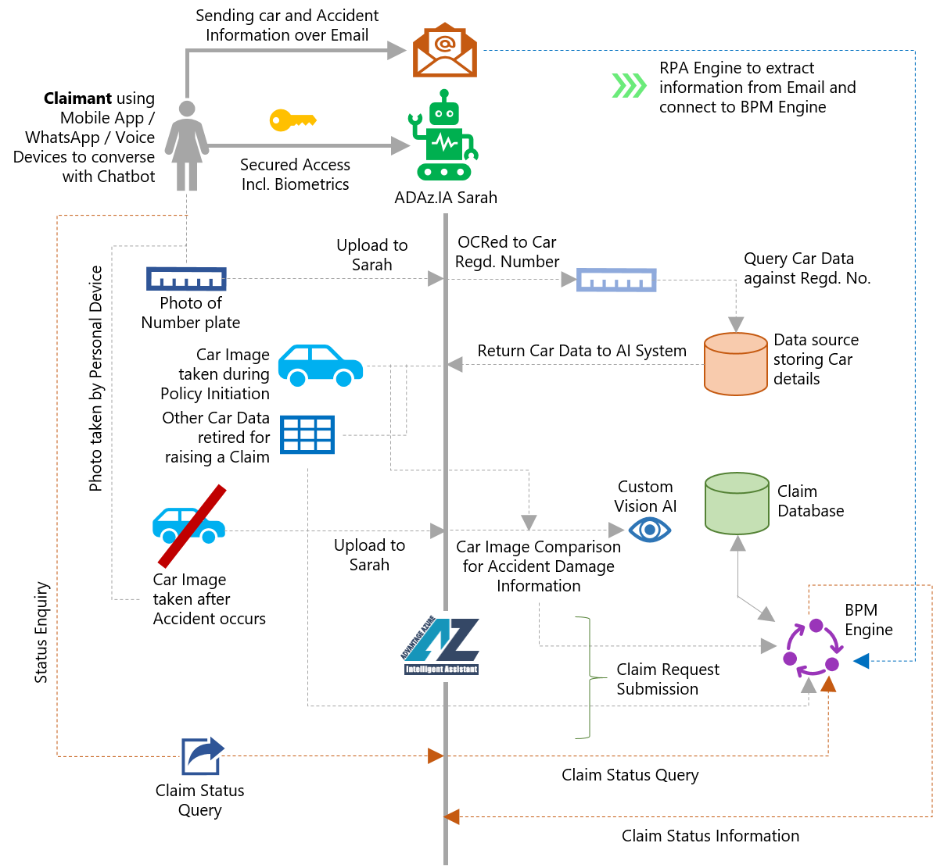
Top ADAz.IA Industry Avatars
Automobile Insurance Claim Automation
Key Features
Access from Claimant’s device even from accident spot of the Automobile
Retrieval of Car and Owner details based on OCR scanning of Number Plate photo
Accident Damage Estimation based on photo difference between initial car photo and photo after accident
Automated Claim raising from the Device itself through BPM Engine
On demand Claim Status enquiry through omni channel BOT
Additional route of Claim through Email via RPA Channels
Future Scope of IOT driven automated accident tracking and zero-touch Insurance Claim
Value Delivery
Paperless Approach towards Faster Claim Process
Faster Claim Approval as no / minimal physical Inspection needed
High Security with Biometric Approach
RPA, BPM, Chatbot integrated solution for end-to-end Claim Processing

Slide 5
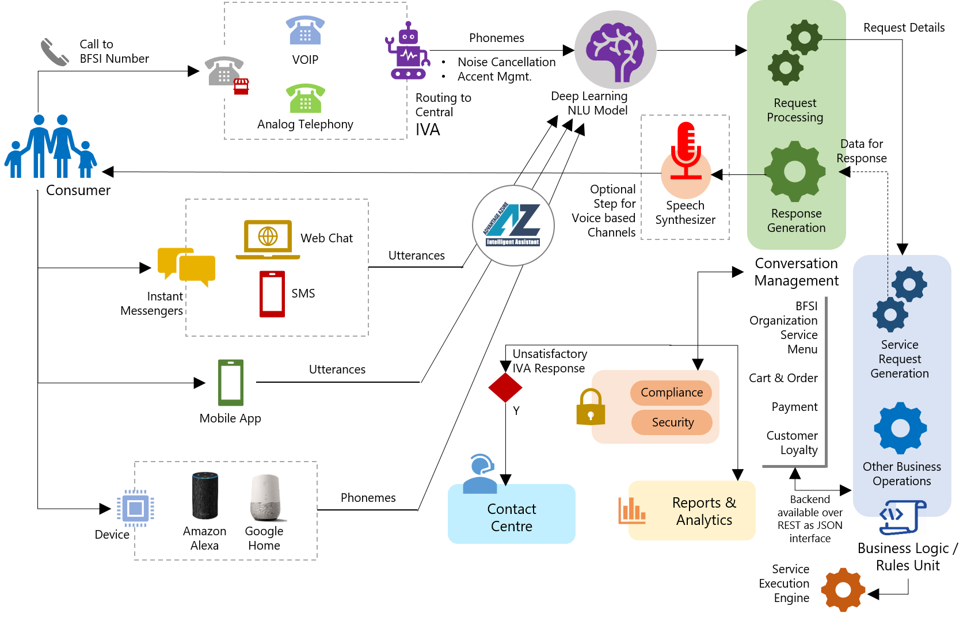
Top ADAz.IA Industry Avatars
Voice based Virtual Ordering Agent in Retail
Key Features
Omni-Channel Ordering experience including Voice based Devices
Voice based Virtual Ordering Agent with Noise Cancellation, Accent Management, Irrelevant Talk Removal etc.
Guided Ordering based on previous Orders from the customer
Secured end to end Order Processing including Payment
Automated Up-Sell and Cross-Sell based on Product choice and Customer Profile
Escalation to human help desk in case Virtual Desk is unable to satisfy Customer
Integrated Reporting and Dashboards for Management Decision Making
Value Delivery
Reduced Human Help Desk size
Less dependency on Human wisdom and attitude to customers
Faster Order Processing
Better Customer Satisfaction due to less wait time as well as guided Ordering
Integrated Reporting helping management to take better strategic decisions

Slide 6
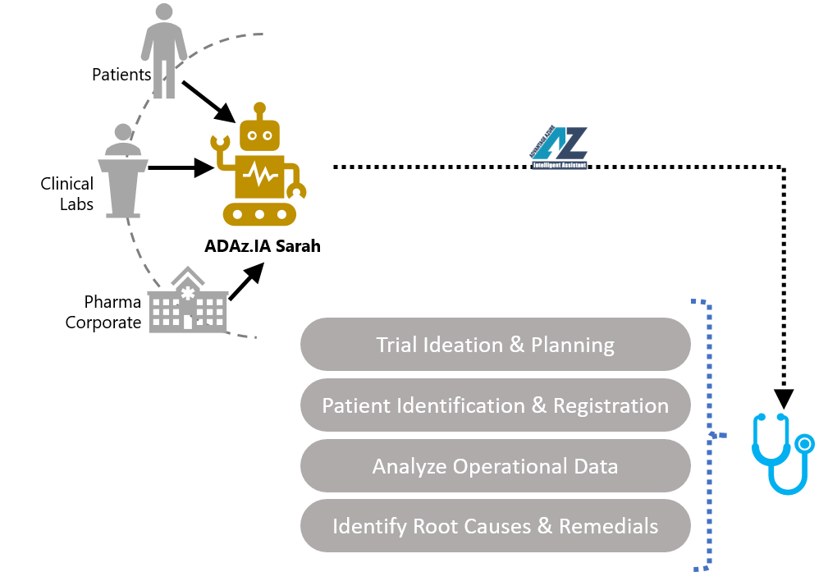
Top ADAz.IA Industry Avatars
Clinical Trial Data Discrepancy Management in Life Science Industry
Key Features
Automation of Clinical Trial Processes through RPA and Chatbot
Machine Learning based Analysis of Clinical Trial Data
Proactive Identification of root causes of the Data Discrepancy
Suggestion of Preventive measures
Sanitizing the overall Clinical Trial Ecosystem from Data Management perspective
Value Delivery
Minimized expense and loss in Clinical Trial process vis-à-vis budget
Improved the Clinical Trial Performance
Faster Clinical Trial Processes
More Intelligent Clinical Trial Operations

Slide 7
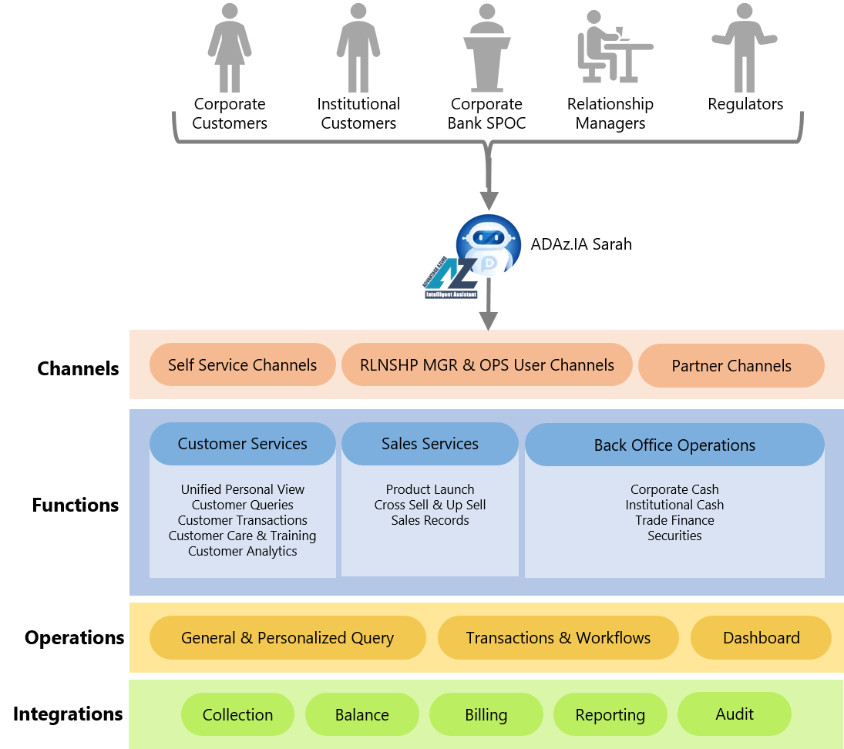
Top ADAz.IA Industry Avatars
Retail Banking Secured User Interaction Agent
Key Features
Anytime Anywhere access to Retail Banking Profile
Secured Retail Banking Transactions under Encrypted Channels
Cascading guided conversation to support Retail Banking Personalized Queries and Transactions
Retail Banking Preference Management at individual level
Correlated Operations guiding Customers to execute transactions optimally
Value Delivery
Ubiquitous access to Retail Banking
Enhanced Security
Ease of Banking over Conversation
Banker’s guidance at any time

Slide 8
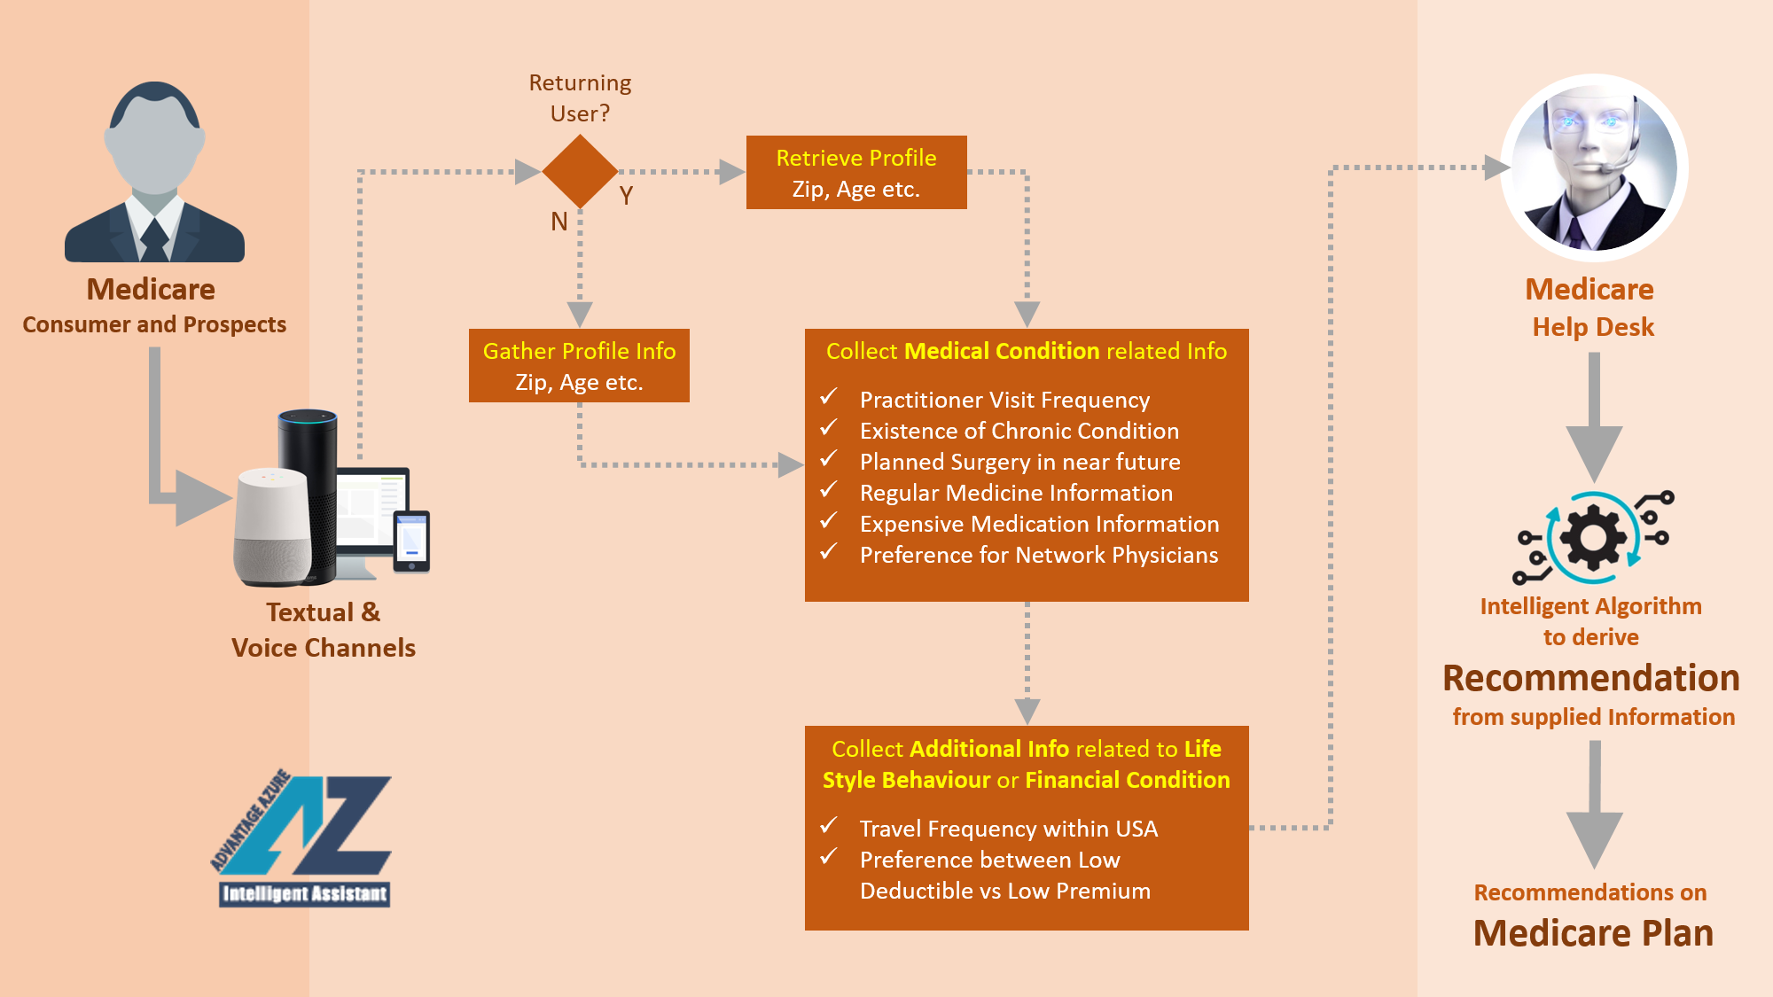
Top ADAz.IA Industry Avatars
Post-Covid Patients’ Intelligent Voice Partner in Healthcare Industry
Key Features
Anytime Anywhere access to Retail Banking Profile
Secured Retail Banking Transactions under Encrypted Channels
Cascading guided conversation to support Retail Banking Personalized Queries and Transactions
Retail Banking Preference Management at individual level
Correlated Operations guiding Customers to execute transactions optimally
Value Delivery
Increased Automation in Every Sector of Healthcare Industry to balance the deficit of Manpower in the sector in COVID-19 Pandemic Era
Human-less Healthcare Actions (Monitoring / Guidance / Communication) with Patients to enable Life Care Provider to support Huge Number of Pandemic Victims
Leveraging Real-Time Intelligence, to take up Proactive Actions towards reduction in Gaps of Healthcare Decisions
Use of Voice based Communications across multiple Languages to reach wide variety of Patients

Slide 9
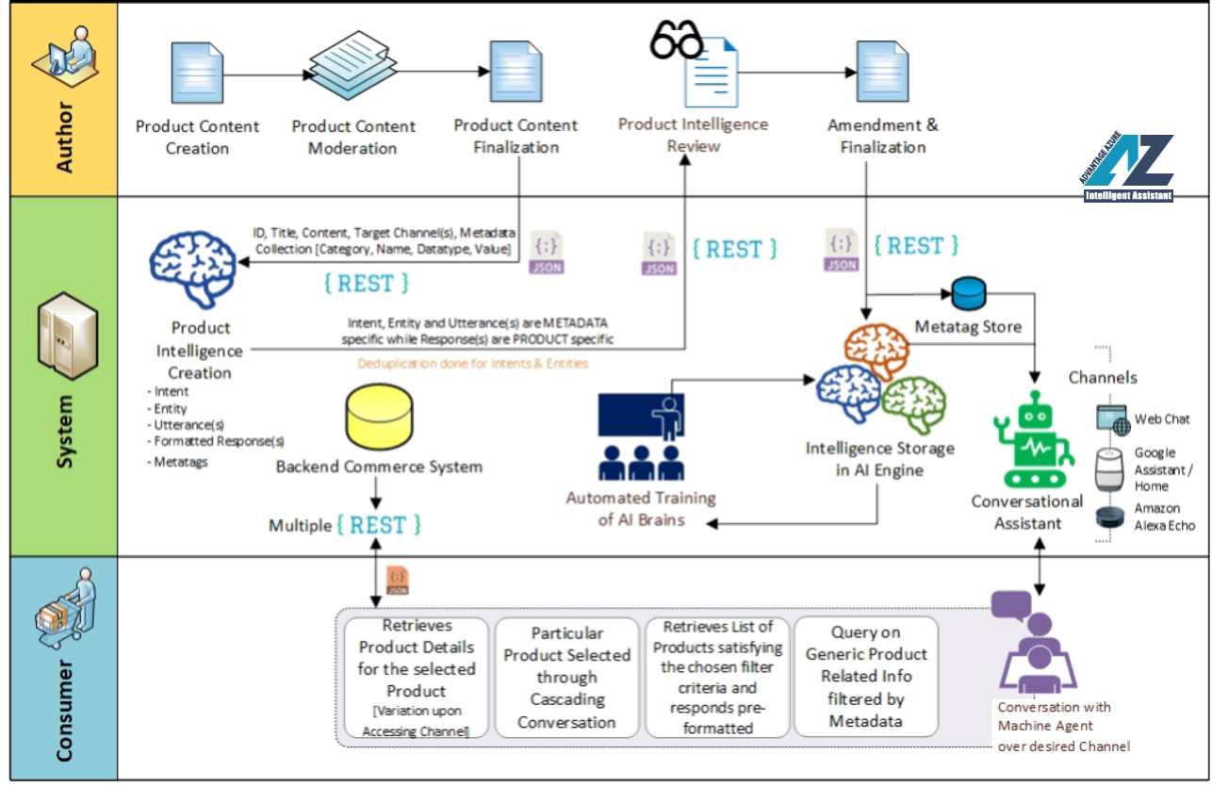
Top ADAz.IA Business Avatars
Intelligent Conversational Commerce Assistant
Key Features
Automated AI Element creation based on Dynamic Product Content Authoring
Automated Meta-tagging on Product Content for better AI Response
Product, Cart and Order Management through Chatbot
High Security Payment Processing over Conversation
Customer Feedback Analysis and Decision Making based on that
End-to-End Voice Enabled
Value Delivery
Simplified e-Commerce with all-round feature set
Anytime Anywhere Access from any Device
High degree of Automation improving Accuracy and Performance

Slide 10
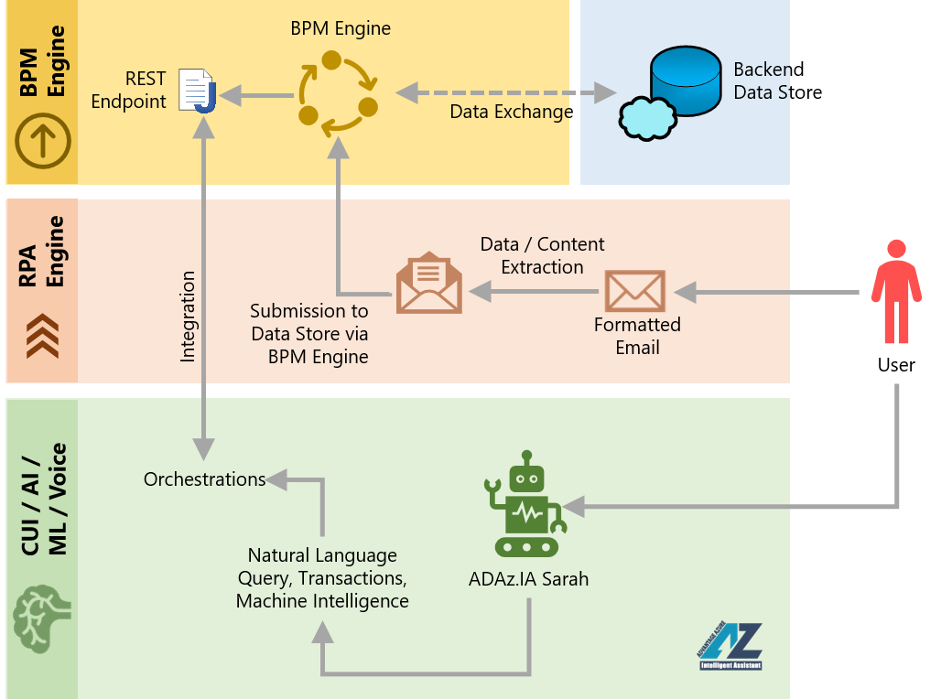
Top ADAz.IA Business Avatars
Process Automation Help Desk
Key Features
Triggering of Processes from Conversational Natural Language Commands
Post Process Execution Status query and Follow up questions on Chatbot
Omnichannel Experience
Appropriate Authorization model for designated execution of Processes
Delegation Facility to expedite processes
Integrated RPA and BPM Engine
Value Delivery
Reduced Human Dependency
Faster Processes
Higher Accuracy
Higher Productivity

Slide 11
Top ADAz.IA Business Avatars
Virtual Data Science and Analytics Provider
Business Objectives
Accessing Reporting Information over Conversation through commonly used Enterprise Instant Messaging Channels
Accessing Reporting Data and Dashboards without knowing access details about targeted Data or Dashboard
Accessing Reporting Information including Dashboards any time anywhere even on popular mobile app(s) or in audio format on regularly used device(s) without intervention of any human being
Interactive Collaboration among workforce on Reporting Information to take better decisions
Textual or Audio representation of complex Dashboards making the Interpretation of charts and graphs easy
Value Delivery
Ubiquitous Access to Reporting Information
Enhanced Utilization of Reporting Information
Faster Decision Making
Improved Adoption of Reporting Information
Functional Features
Query on Raw and Summarized Reporting Data
Different personalization-enabled Style of representing retrieved Reporting Data
Query to display Dashboard as Image as well as Interactive Dashboard
Collaboration of Multiple human Users simultaneously with Conversation based Machine User on Data and Dashboard
Auto-generated Description of Reporting Dataset and Dashboard
Protected Access to Data and Dashboard
Optimized Training as Combination of Predefined Knowledge Base and Controlled Training
Non-Functional Features
Natural Language Capability for both Processing User Requests as well as Content Generation
Multistep Cascading Query Processing
Availability on diverse Channels – Web Chat, Skype for Business, Slack and Microsoft Teams
Availability of Voice Channels and Devices – Amazon Alexa, Amazon Echo, Google Assistant and Google Home
Authentication and Authorization Protection
Contextual and Personalized Data / Content Access
Caching and Auditing delivering tuned Responses
Multilingual Support

Slide 12
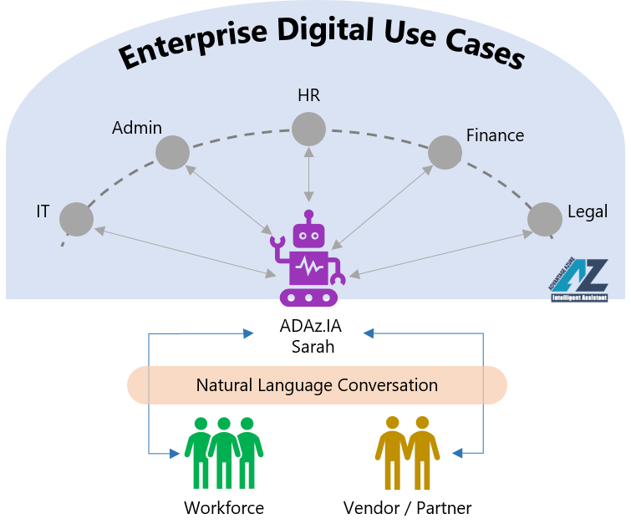
Top ADAz.IA Business Avatars
Enterprise Digital Assistant for Workforce / extended Workforce
Key Features
Omnichannel Enterprise Digital Conversational Assistant
Integrates and implements all Enterprise Operations like HR, Admin, IT, Facilities, Finance etc.
Supports most Enterprise IMs
Multi User Conversational Collaboration with Machine where SME involvement needed
Includes access to Vendors, Partners and Agents along with Workforce to automating processes around
Value Delivery
Reduced Help Desk Load
Decreased Service Wait Time
Improved Productivity
High User Satisfaction making Workforce Motivation and Adoption high

Slide 13
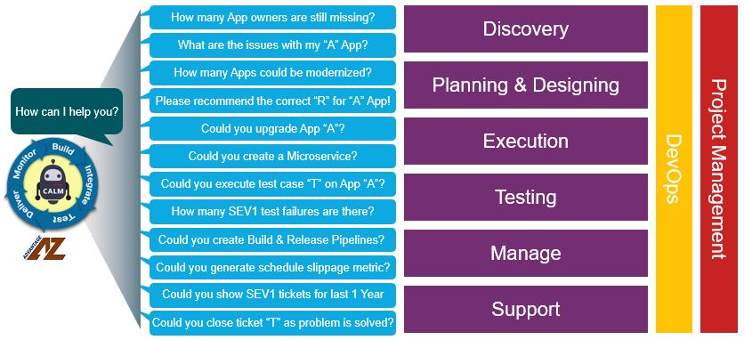
Top ADAz.IA Business Avatars
Program Management and DevOps Guide
Key Features
Advanced Program Management and DevOps services for IT Managers, Scrum Masters and Project / Program Managers
Standard Process Execution like Planning for a new project, Pre-up for a Stand-up meeting, Prepare a sprint summary, Verify current burn-out ratio, sprint velocity, Verify resource-level productivity and Advice to mitigate critical risks
Guidance on ideal sprint velocity, burndown ratio, backlog to resource ratio based on past account level historic records of similar project
Troubleshooting Guidance while Program in Crisis
Consolidate report about any individual team member (no. of times he/she missed key milestones, backlog, burn down rate, key success factors / contributions)
Value Delivery
Flawless Program Governance
Preventive and Faster Corrective Actions
Real Time Sprint Governance
Easy and Accurate Decision Making

Slide 14
Thank You

