Slide 1
ADvantage Azure
Intelligent Assistant
A Summarized Walkthrough

Slide 2
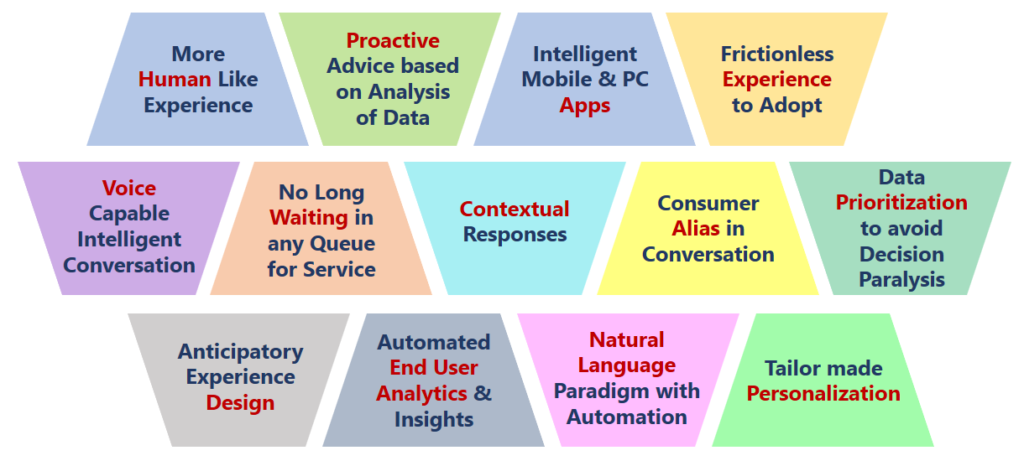
Typical Business Conversation Pains

Slide 3
What is
ADvantage Azure Intelligent Assistant is a Manifestation of Human-Machine Partnership through Intelligent Business Conversation for diverse queries and reactive / proactive Actions on various Industry specific Digital Functions

Slide 4
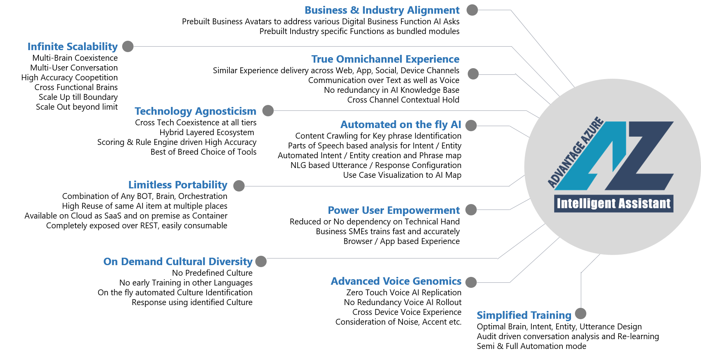
Key Differentiators

Slide 5
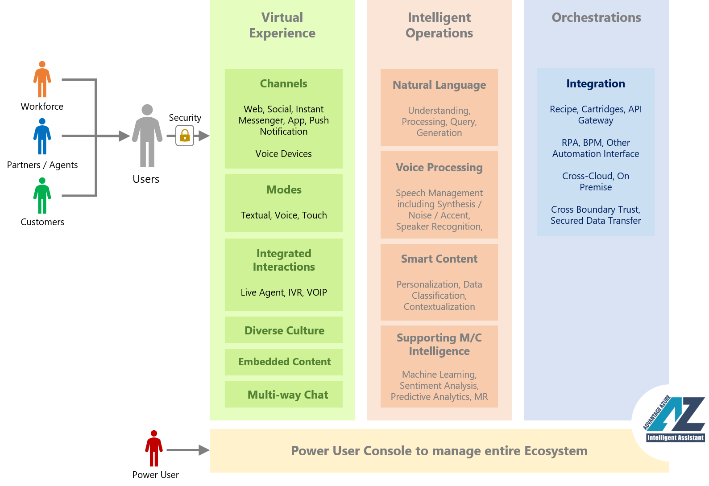
Simplified Approach

Slide 6
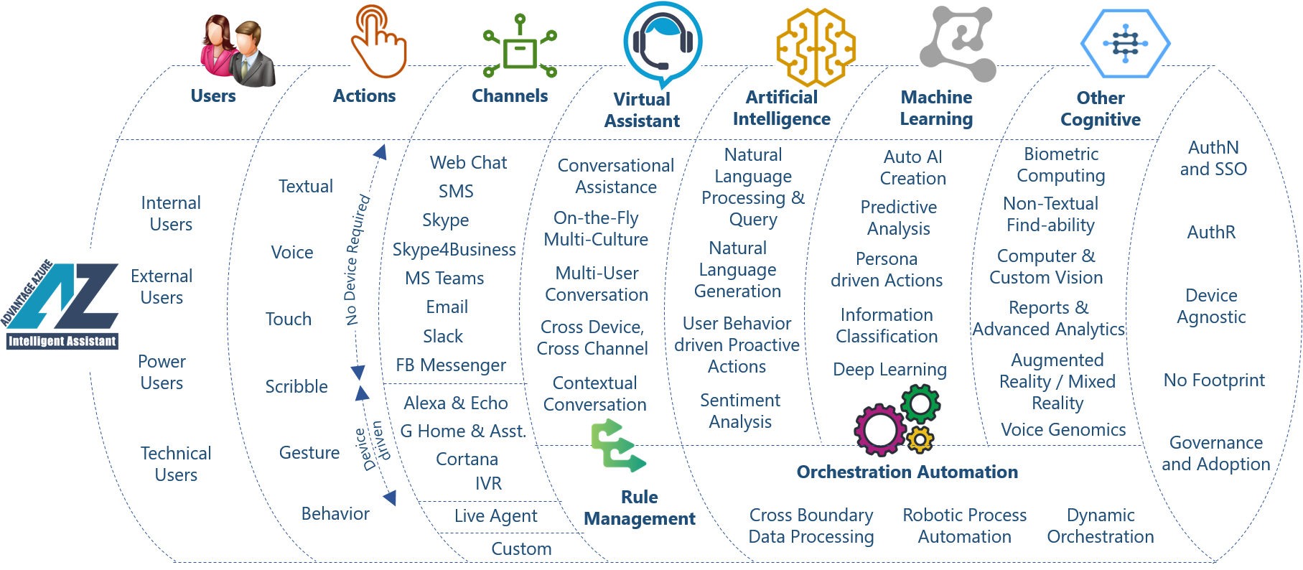
Construct

Slide 7
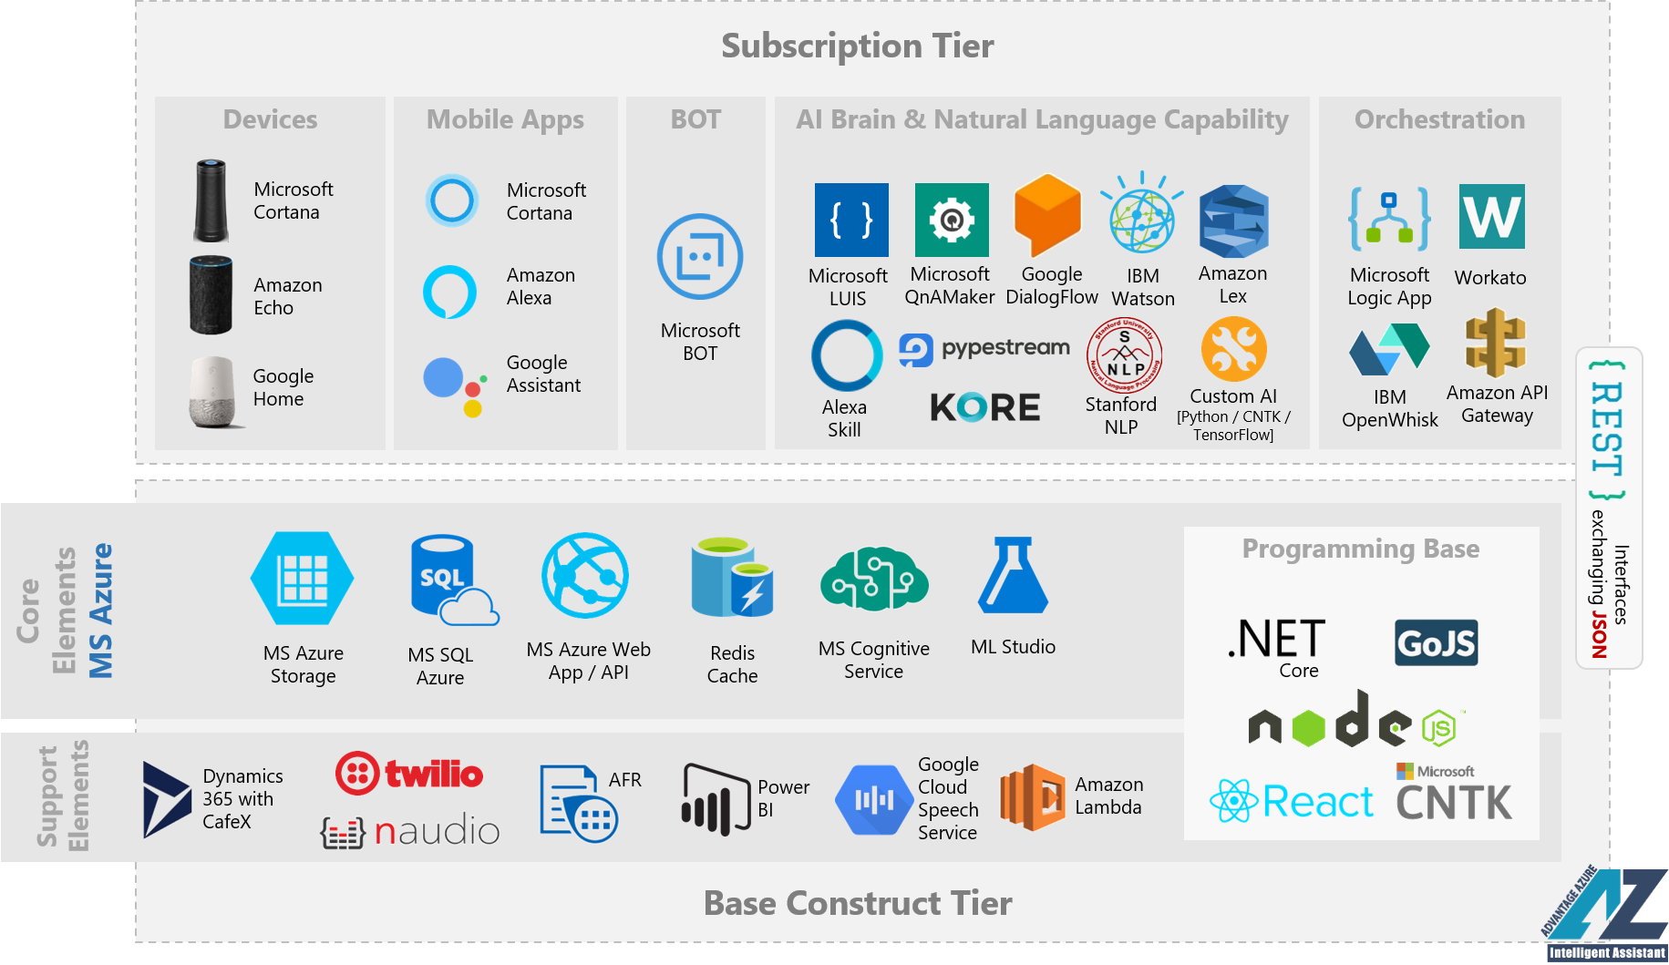
Technology Stack

Slide 8
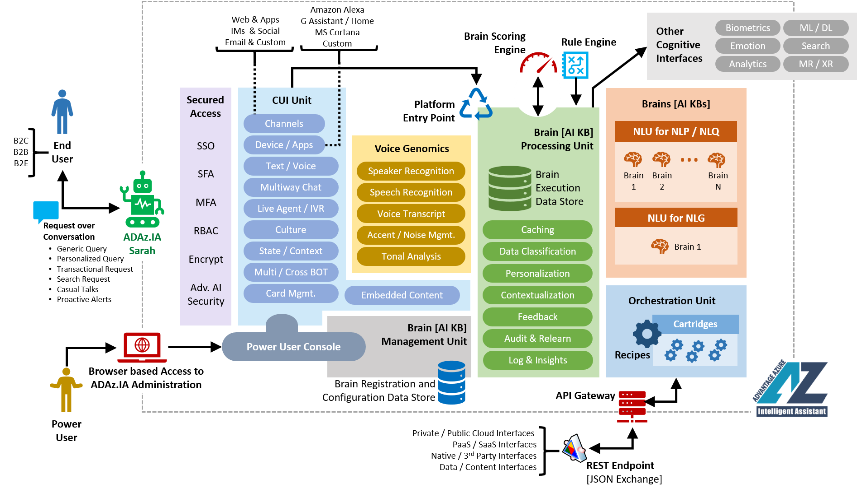
Logical Architecture

Slide 9
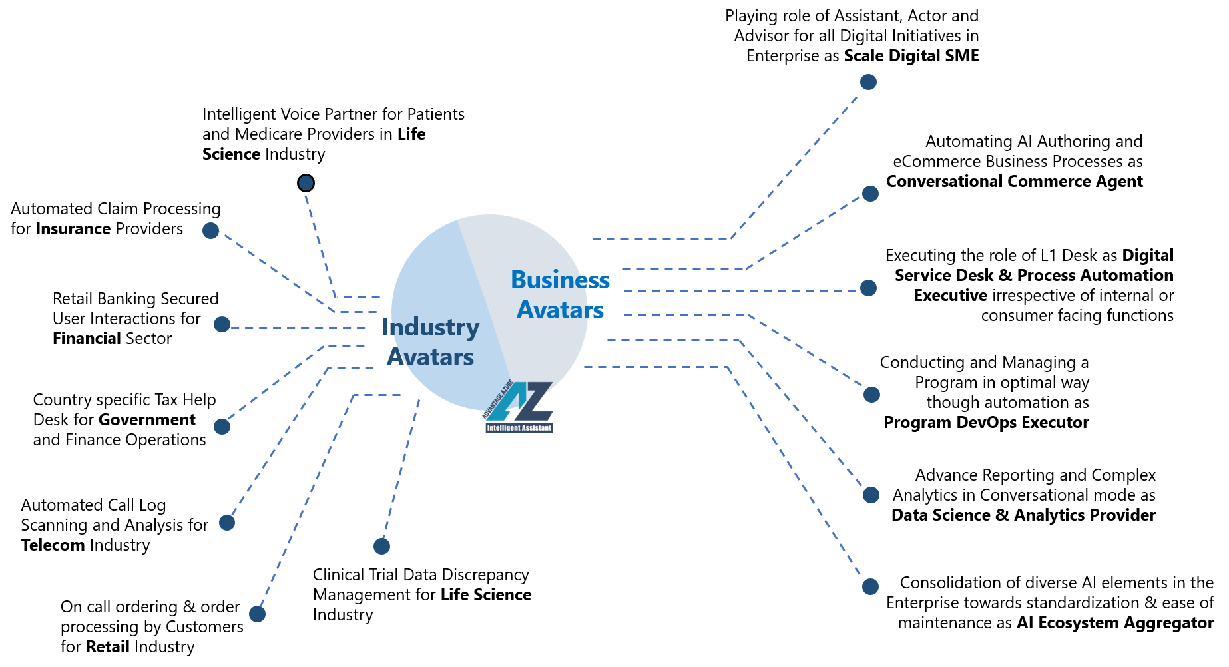
Prebuilt Avatars

Slide 10
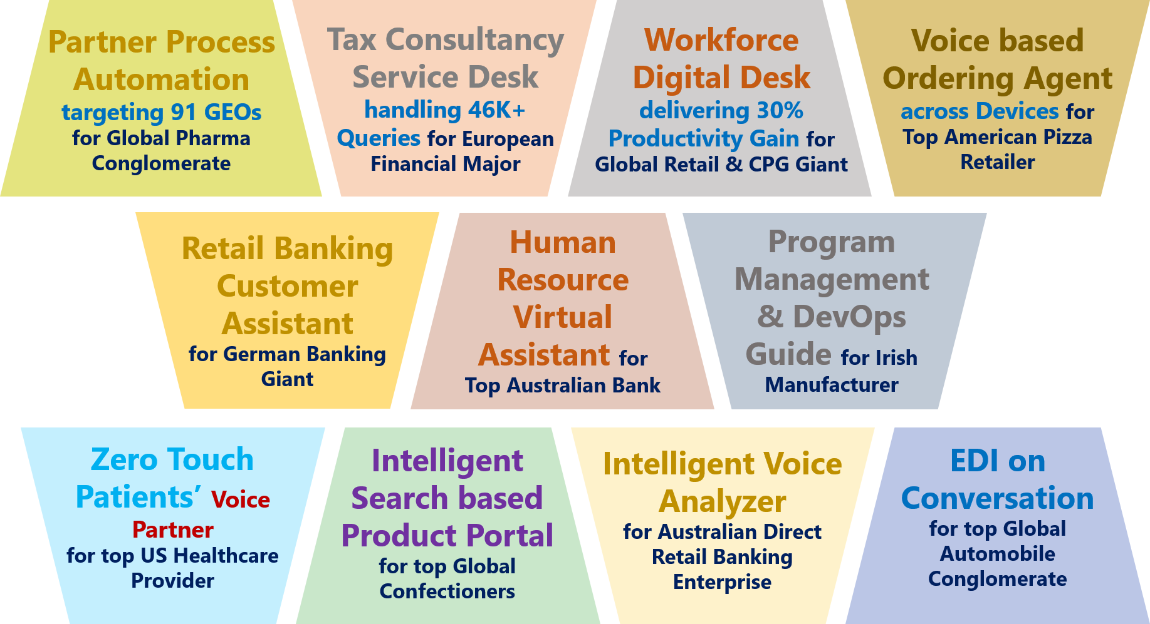
Top Experiences

Slide 11
Thank You

