Slide 1
ADvantage Azure
Intelligent Assistant
Success Stories

Slide 2
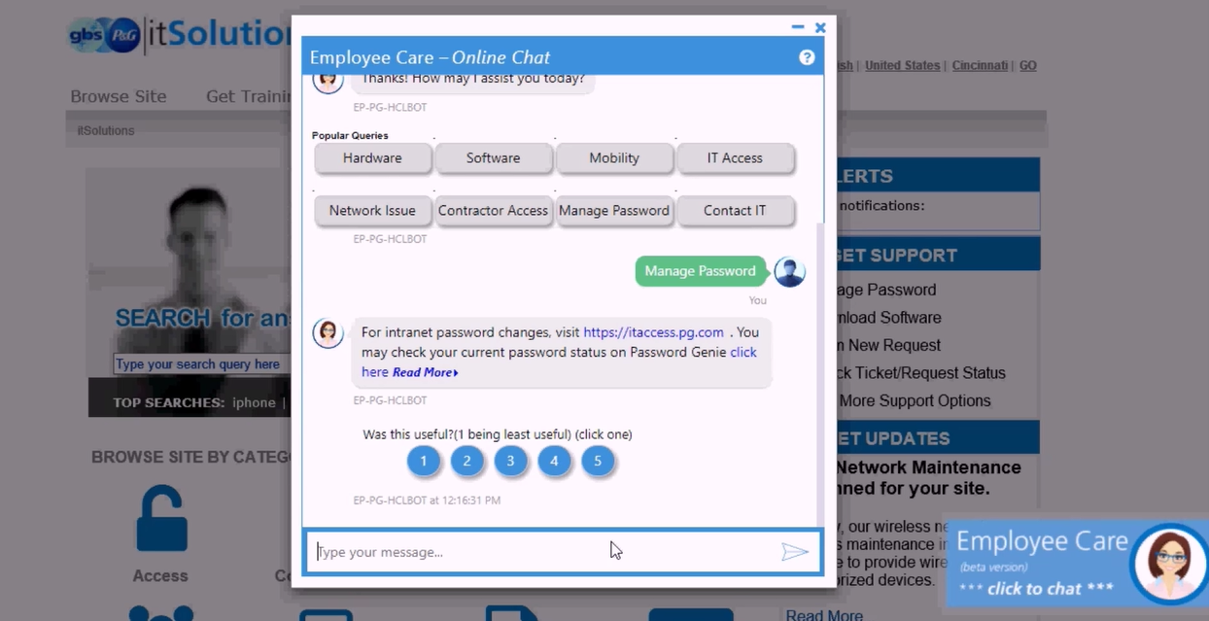

Employee Help Desk
at Global Retail & CPG Giant
Customer Profile
Global Retail and Consumer Goods Corporation, founded in 1837 and headquartered at Cincinnati USA, with around US$ 85 billion of revenue having 100+ brands under its umbrella operating across 6 continents supported by 92K+ workforce across the geographies.
Key Challenges
Numerous Help Desks across functions / departments resulting low adoption
Phone calls often leading to Long Waiting and also Longer Resolution
Various Departments having own BOT from disparate technology platforms e.g. MS, IBM, PypeStream etc., hence user access also diversified
No Cross-boundary integration with different native applications demanding manual correlation between datasets to consolidate
Missing proactive intelligent and automated communication
Dependency on Tech Team for simple changes causing low Productivity
Solution Provided
Single Point Access to all Departments through a centralized BOT connecting all child brains in a multi brain ecosystem uniquely offered by HCL’s ADAz.IA Platform
Supporting 20K+ employee set with 2000+ use cases across departments
Power User driven web console to register, configure and provision BOTs / Brains / Orchestrations reducing dependency on technical team in BAU cycle
Coexistence of Brains from various technologies executing intelligence in parallel
Integrated with several backend system within customer data centre, third party vendor system or on cloud services using API Gateway model
Inclusion of Personalization and Contextualization features
Simplified semi automated Training towards high accuracy
NFRs like multifactor authentication, caching, multi lingual included
### is working toward automating as much as 90% of claims investigations in the accounts-receivable division next year, and a bot named Lucy helps quickly answer questions from employees about technical issues and benefits, Mr. Polit says. Early tests this year show the bots are increasing productivity in their areas by as much as 30%, he says.
Source : https://www.wsj.com/amp/articles/technology-innovation-isnt-just-for-tech-companies-1512505931
Notes:
P&G

Slide 3
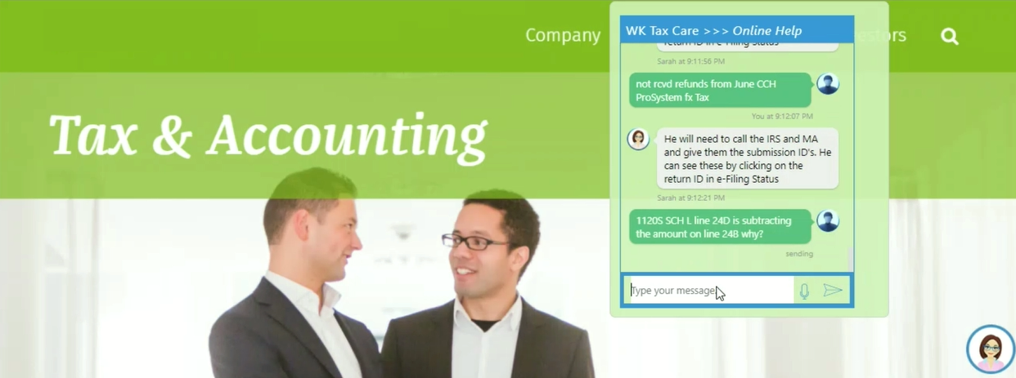
Tax Consultancy to Public Audience
at European Financial Major
Customer Profile
A global provider of professional information, software solutions, and services for clinicians, nurses, accountants, lawyers, and tax, finance, audit, risk, compliance and regulatory sectors. The company is headquartered in Alphen aan den Rijn, Netherlands with a revenue of with EUR 3.7 billion revenue.
Key Challenges
Tax Service Desk was flooded with User Calls resulting no bandwidth
Long waiting hours for Users for simple queries
Work Pressure resulted inaccuracy in responses
Huge volume of Use Cases to maintain and refer while responding
Solution Provided
47000+ Tax Queries consolidated with answers under a natural language enabled ambience
A cognitive platform accessible from anytime anywhere over various channels and auto-detectable multilingual capability by users for Tax related queries
High Scalability to support initial load and addition of 10K+ new queries every year
High accuracy w.r.t. query responses resulting significant improvement in user satisfaction
Automation of query resolution energized internal operations and improved service quality
Notes:
WK EU

Slide 4
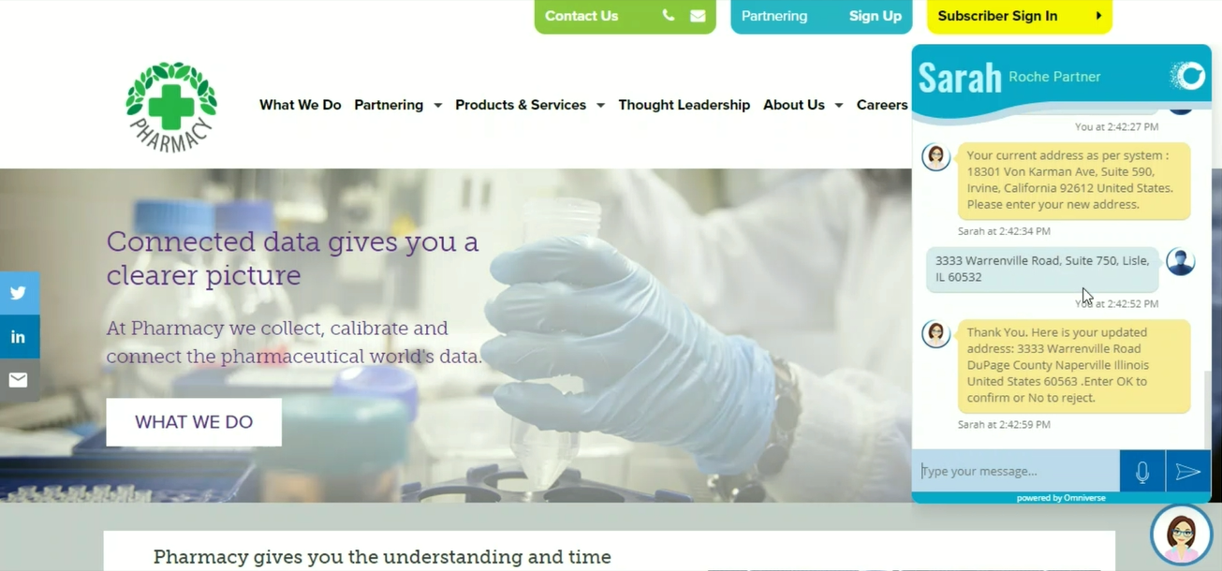
Partner Process Automation
at Global Pharmaceutical Conglomerate
Customer Profile
Customer is a Multinational Healthcare Company that operates worldwide under two divisions – pharmaceuticals and diagnostics. Headquartered at Basel, Switzerland with 94K+ employee base globally recording a market cap of US$ 209Bn+.
Key Challenges
Business Processes are not integrated resulting a lot of Human Dependency
Processes are slow and error prone due to huge workload on employees
Overall Productivity becomes low due to slow processes and reduced workforce motivation
Relationship with Vendors / Partners deteriorates because of lack of transparency and delayed operations
Solution Provided
Implemented a Solution having three components RPA, BPM and Conversation UI working hand in hand
RPA Process initiation based on Natural Language Commands given via conversational interfaces
Query and Transactions on BPM backend directly from conversational UI based on user’s privilege and access level
Generic FAQ responses and Standard Dashboard display within Intelligent Chat interface itself
Notes:
Roche

Slide 5
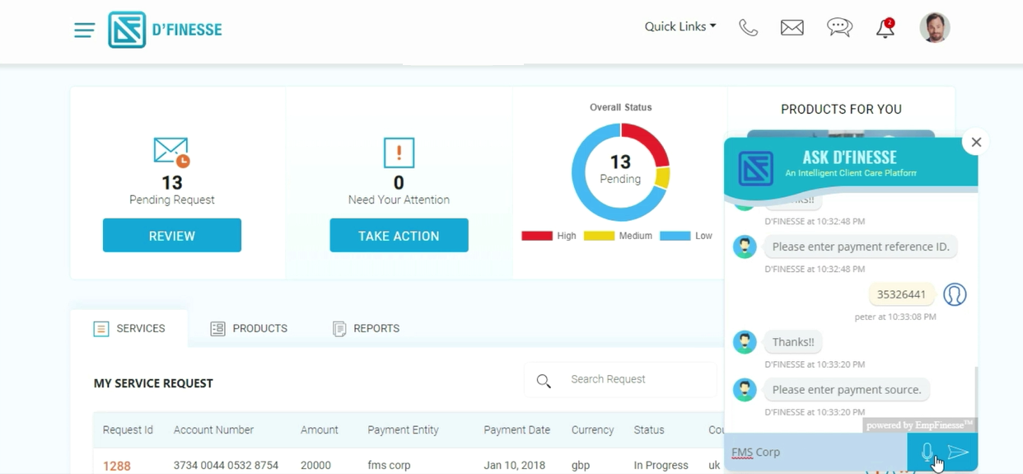
Retail Banking Customer Assistant
at Largest German Bank
Customer Profile
Bank operates in 58 countries being 15th largest bank in the world by its assets. Headquarter in Frankfurt having revenue of 25+ Billion Euro. Operates in all segments like Private & Commercial Banking, Corporate & Investment Banking and Asset Management.
Key Challenges
Customers were facing issues in following the right navigation to access personal data and execute required transactions
A single point entry for all Retail Banking operations without any involvement of Banking Executive
Solution Provided
Retail Banking BOT catering to both anonymous and authenticated customers
Available on Retail Banking Website as well as Voice BOT direct access
Handles query, transactions, recommendation, proactive notifications etc.
Personalized and Data Classified content, information and data delivery over BOT interface
Notes:
DB

Slide 6
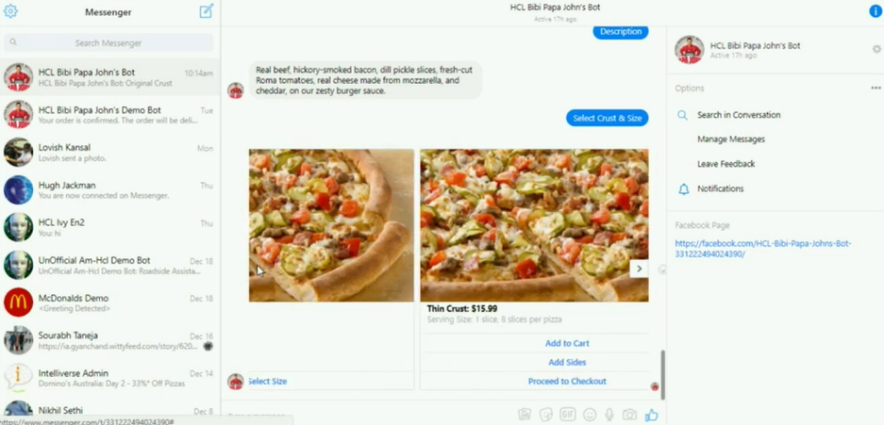
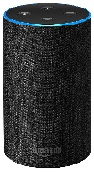
Pizza Ordering Agent
at America’s 3rd largest Pizza Chain
Customer Profile
America's 3rd largest Pizza chain, founded in 1984 and headquartered in Jeffersontown Kentucky, having 5200+ stores. Numbers show a Revenue of US$ 1.78 billion with 20700+ employees on ground.
Key Challenges
Customer was experiencing a drop in sales attributed to the fact that competitors being able to provide innovative service and attracting more customers
Consequently stock price was also falling
Customer wanted a better Experience delivery to its customers by modernizing their IT to remain competitive
Solution Provided
Voice BOT based ordering solution driven by ADAz.IA platform deploying a virtual assistant in voice mode over Amazon Alexa
ADAz.IA based solution was available on various channels like FB Messenger, Telegram, Web based Voice Chat, Twilio etc.
The voice ordering solution was made secured using a tokenization service
Amazon Alexa
Notes:
Papa Johns

Slide 7
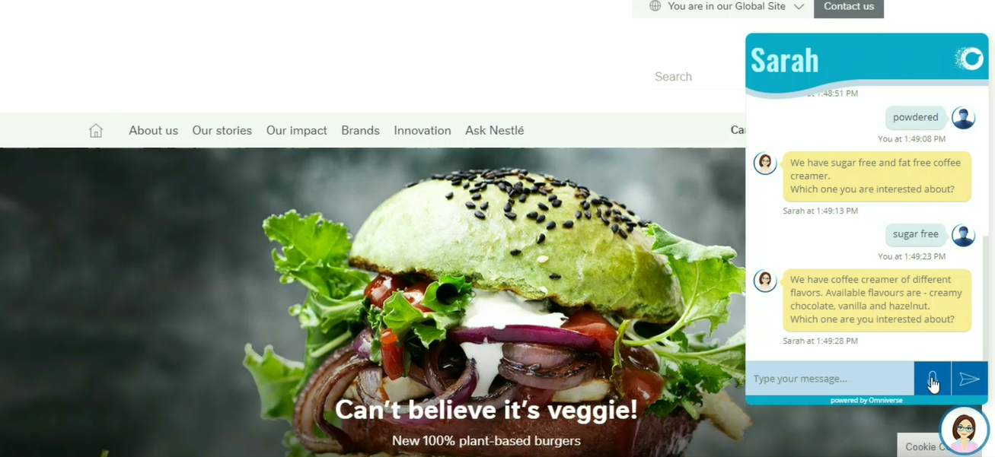
Online Product Search Agent
at World’s Favourite Coffee Maker
Customer Profile
Customer is a Swiss multinational Food and Beverage Conglomerate headquartered at Vevey, with a revenue of around CHF 90 Mn and global employee base of more than 300 thousands.
Key Challenges
Reduced Customer Footfall on the Product Portal
Complex or unclear Search Mechanism
No direct connect to associated information like ecommerce and related location information etc. after search
No facility for anytime anywhere Product Search
Solution Provided
A chat based virtual helper to browse & search Product Catalog
Availability on Website as well as through voice apps like Google Assistant and Alexa
Direct Connects to e-commerce channel and links to purchase
Upsell through Recipe Download related to searched Products
Notes:
Nestle

Slide 8
Intelligent Voice Analyzer
at Australian Direct Bank
Customer Profile
Customer is a 25 years old direct bank in Australia headquartered in Melbourne with AUD 27.3 Bn assets with just around 2000 workforce. Bank’s unique model of branch less operations is a path-breaking model in global banking industry.
Solution Provided
Recording of Voice Calls between Customers and Call Centre Agents collected for certain duration
Text Transcript was generated for Voice Recordings excluding noise factors and addressing accent related issues
Rule based shortlisting done for Analysis Candidates from the generated Transcript
Key Phrase Extraction was done and Prime Concerns from customers were identified
Sentiment Analysis was done on Transcripts to identify the reason(s) of the Customer Churn
Analyzed data was fed into Analytics Engine
Dashboards and Reports were produced
Recommendations were done for Corrective Measures
Key Challenges
Bank’s Operations very much depending on Call Centre
Customer Churn was come across in survey but root causes not known
Call Centre Agents performance, productivity and expertise never measured
Notes:
ME

Slide 9
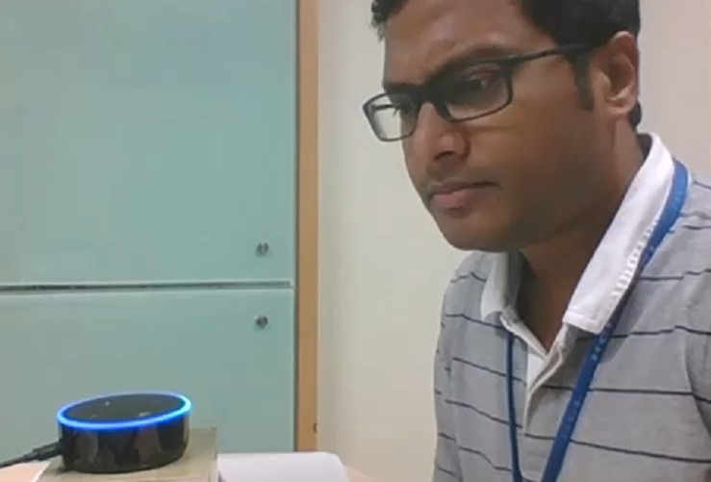
Post-Covid Patients’ Voice Partner
at Top US Healthcare Service Provider
Customer Profile
Customer is a New Jersey based Healthcare Incorporation with 5000+ customers addressing 5+ Million Patients' need offering diverse Wellness Solution to its consumers.
Key Challenges
Post Pandemic Reduced Manpower
Touch to be avoided as much as possible
Too Frequent seeking of Healthcare Guidance / Action / Decision
High density of aged Patient population who are uncomfortable with typing long requests
Long waiting time to get assistance
Solution Provided
Voice based Virtual partner across Apps & Devices with On Demand Multicultural Support
Intense Voice Ecosystem on Centralized Intelligence with Noise and Accent Management
Integrated Healthcare Business Processes and Backends to deliver right information right there with high accuracy and pertinent relevance
Voice Audit, Actionable Sentiment Analysis, Predictive Analysis to ensure better intelligent data delivery and guidance
Advanced accurate decision making through Analytics
Notes:
EHI

Slide 10
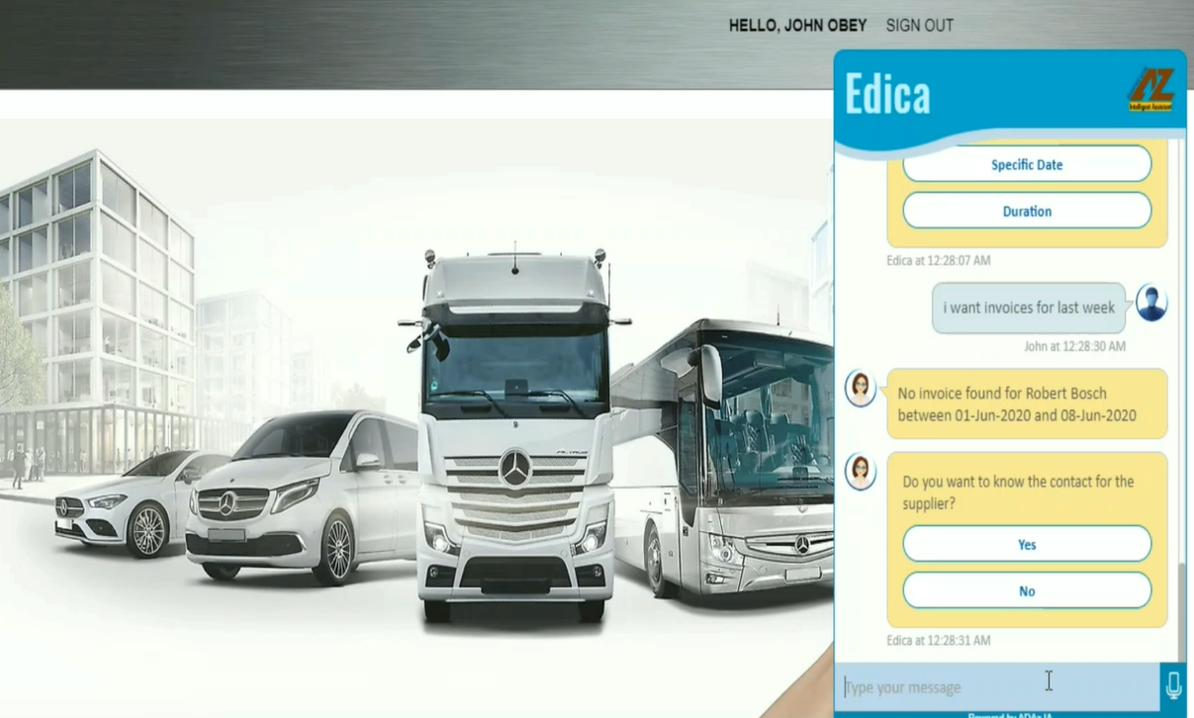
Conversational Enterprise Data Interchange
at Top German Automobile Conglomerate
Customer Profile
Customer is a German multinational Top Automobile Conglomerate headquartered at Stuttgart, Germany, with a revenue of around EUR 173 Bn and global employee base of around 300 thousands.
Key Challenges
Reduced Customer Footfall on the Product Portal
Complex or unclear Search Mechanism
No direct connect to associated information like ecommerce and related location information etc. after search
No facility for anytime anywhere Product Search
Solution Provided
NL capable Virtual Partner for EDI driven use cases using HCL’s ADAz.IA
A Tech-agnostic Multi-AI-Brain and Multi-lingual Capable Virtual Partner with Omnichannel (including Mobile Apps & Voice Devices like Google Assistant or Amazon Alexa) access over text and voice with continuously evolving High Accuracy through supervised and unsupervised AI Training
Secured Access to the data and documents with RBAC visibility filter check
Easy access to Data over flexible REST / JSON based Integration through API Gateway facing Secured Channel
Browser based Power User Console for easy Management of AI Knowledge Bases by Business Users themselves
Functional Coverage includes –
  Query / Search Transaction Status
  Download EDI Data / Documents as required
  Retrieval of Transactions based on keywords / reference (delivery forecast, invoice etc.)
  Execution of Transactions to Backend EDI Systems
  Retrieval of Artifacts e.g. Invoices, PO in the Chat itself
Notes:
Daimler

Slide 11
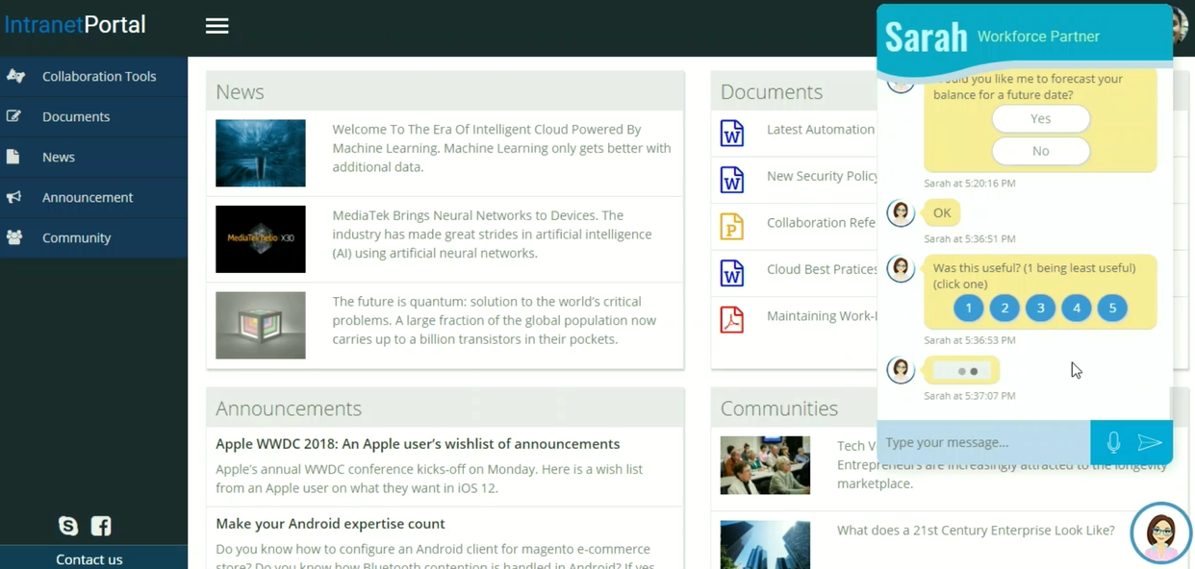
Human Resource Assistant
at Top Australian Bank
Customer Profile
Founded in 1911 by the Australian government and fully privatized in 1996, this Bank is one of the 'big four' Australian banks. Headquarter at Darling Harbor Sydney, it scores a revenue of A$ 26 Billion with around 52000 employees.
Key Challenges
Increasing Support Calls to Internal Service Desk for Human Resource Department
Frequent requests for routine Queries / Actions consumes more time leaving low bandwidth for Complex Issues
Hardly referring to Data Trends / History Data to take Proactive actions towards prevention of any issues
Solution Provided
Introduced HR Personal Assistant with natural language capability for all L1 Queries and Actions without human intervention
Seamless transition to / from Live Agents to BOT from same Conversation Window offering a unified experience to employees
Continuous Monitoring of Transaction Data by BOTs to raise alerts on anomalies as per pre-set rules proactively
User Feedback based training
Power User driven Administration and Maintenance Console
Notes:
CBA

Slide 12
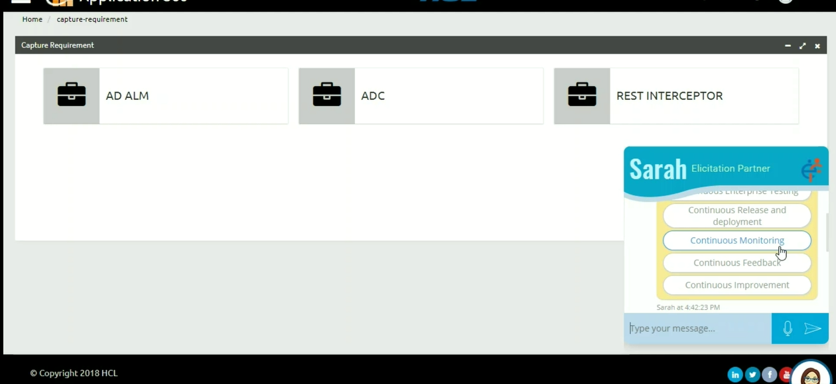
DevOps Assistant
at Irish Financial Service Operations Company
Customer Profile
Customer is a consumer credit reporting company who collects and aggregates information on over one billion people and businesses including 235 million individual consumers and more than 25 million businesses. Headquarter at Dublin deals with a revenue of US$ 4.7 billion.
Key Challenges
Analysis of Requirements registered takes a lot of time when done manually
Cross System data pulling require manual intervention introducing error and delay
A graphical output helps a lot for faster understanding
Solution Provided
Application 360 / CALM is the solution through which DevOps life cycle is supported in all aspects where BOT is positioned as anytime assistant
ADAz.IA enabled conversational assistant answers queries, retrieves documents and reports, showcase media and takes feedback to ensure a better governance around the program
Notes:
Experian

Slide 13
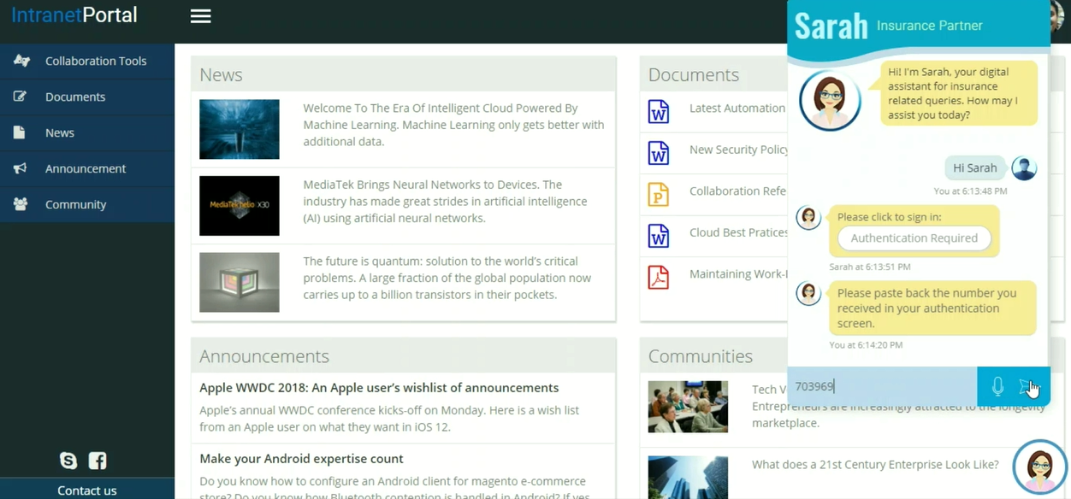
Billing Help Desk
at German Insurance Agent
Customer Profile
Customer is one of the world’s leading reinsurance company based in Munich. Operates across the globe, founded in 1880, holds a revenue of EUR 49.1 billion.
Key Challenges
Addressing Billing and Payment Queries with no human interaction
Executing Payment Transactions with no manual intervention
Integration with IVR System as one of the branch
Communications in both Textual and Voice mode
Solution Provided
Processing all online billing and payment in automated way using ADAz.IA BOT
Integration with Payment Gateway from Conversation itself
Seamlessly integrated with IVR and Live Agent System
Addressing 100+ actions & numerous queries around billing & payment via same BOT
Voice enabled multilingual implementation
Analytics to improve Billing Help Desk performance
Notes:
MunichRE

Slide 14
Conversation Platform Build
at Global Technology-led Business Process Solution Provider
Customer Profile
Customer is a technology-led business process services company headquartered in New Jersey. It was formed in 2017 as a divestiture from Xerox. The company offers digital platforms for businesses and governments. It has 93,000 employees in more than 40 countries and generates a revenue of U$ 6.6 billion.
Solution Provided
Single Platform available for Multi-Channel Access
User can communicate in Multi-Mode
Platform work with devices like Alexa, Google Home, and Apple HomePod
Voice Assistant answers basic questions without full-time employee interactions and is available 24/7
Beyond providing personalized, on-demand requested information, Voice Assistant can engage with customers to provide solution to users.
Key Challenges
A virtual agent to be developed which were required to be
  Platform-based
  Omni-channel
  Customer centric
  Technology agnostic
  Easily deployable and maintainable
Customer to sell this as a platform to its customers
Notes:
Conduent

Slide 15
Thank You

