Slide 1
Data First Philosophy
A Brief Walkthrough

Slide 2
Core Construct
1
2
Intelligent Data Management
Adaptive Data Platform
End to end Lean Data Management processes enabled by AI, ML and Knowledge Ecosystem
Enterprise Metadata Management
Self-Healing Data Quality
Master Data Management
Enterprise Data Governance Charter
Trust based Data Governance
Data platform built on principles of data fabric to make data made available and accessible in a timely manner for enterprise and customer centric consumption services
Data Platform on Cloud
Adaptive Data Acquisition & Refinery
Ubiquitous Data processing
Real time data streaming
Data First Approach
Right Data made available Consistently, at the Speed at which the business can benefit from its Use
Automate data operations delivering consistent experiences through better practices, tools and processes leading to better collaboration between Data consumers & Data Suppliers
Data Orchestration
Automated Data Testing
Continuous Data Monitoring
AI / ML driving data processes
Ecosystem with multitude of services from Information to Insights for driving business experiences
Data Storytelling using conversational BI
Embedded Analytics
Insights As A Service
Applied AI
Automated Data Quality Operations
BI Operations
Data Literacy
Democratize data to empower client business stakeholders
Uberized Data delivery using APIs
4
Smart Data Operations
Consumption based Analytics
3

Slide 3
Approach in a Nutshell
Data First Tenets | Service Offerings | Initiatives | Accelerators
Intelligent Data Management | Enterprise Metadata Management – Data Catalog I Data Definition Self-Healing Data Quality Master Data Management – On-Premises / Cloud Data Governance Charter Trust based Data Governance Data Management Platform As A Service | Define Data Ownership for key business domains Establish DQ Monitoring and associated scoring algorithms to improve effectiveness Establish stewardship processes around data ingestion, processing, storage, data quality and data management Build Agile MDM Solutions Create operating model for data stewardship services encompassing plan, build and run | Meta Wisdom Data Hallmarking ADvantage DQ (erstwhile R2D2) Data Management Pathways
Adaptive Data Platform | Ubiquitous Data processing (for various formats, scale, breadth of sources and depth of tech) Transversal Data Platform on Cloud Data Ingestion As A Service Real time data streaming to deliver multitude of business services | Data Platform at the center of data provisioning needs of the client’s data consumers. Platforming and architecting new transversal data platform in cloud Pursue the new build workload-by-workload basis and setting up the environment for efficient future initiative support Simplifying data tech ecosystem Offloading data from Legacy to New age data platforms | ADvantage Sketch ADvantage Gatekeeper PerisKop HiFlyer
Consumption Based Analytics | Democratize data to empower client business stakeholders Uberized Data delivery using APIs Data Storytelling using conversational BI/ Embedded Analytics Data Marketplace in Pub-Sub Model Insights As A Service (Pervasive / Ubiquitous Platform) BI Fabric to manage BI estate | Build Insights As A Platform to deliver analytical use cases Develop data marketplaces for data consumers Building a Semantic layer for data discovery Cognitive Data Marketplaces powering ease of use in accessing data / Insights Build conversational BI facilitating Self-service and empowering business One place for data consumption (Commoditize) | Data Marketplace Conversational BI Model Manager ADvantage Intelligent Assistant Analytics Pathways
Smart Data Operations | Data Orchestration Automated Data Testing and Data Monitoring Enterprise Operations Process Console AI / ML driving data processes Automated Data Quality Operations BI Operations Data Literacy | Streamlined processes, improve collaboration, and establish a culture of continuous improvement. Use of automation to increase agility, speed and free capacity for new work End-to-end data ownership Increased Speed, Quality and scalability of data pipelines Increased Model management Lean Data Ops team moving towards Citizen Data Science Skills and roles | Meta Wisdom iSee ADvantage Gatekeeper ADvantage DQ Power BI Cockpit Know Me

Slide 4
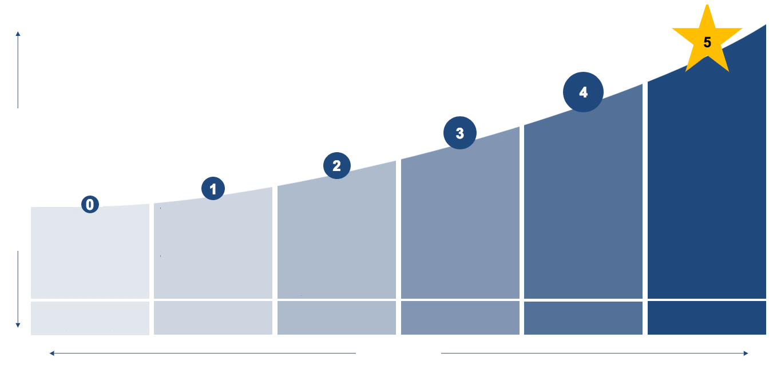
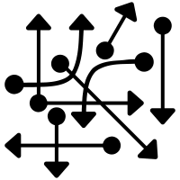
Maturity Journey
World-class
Transversal
Governed
Foundation
Federated
Ungoverned
AI driven business aligned DataOps
Data driven insights ingrained into processes accessible across business
Actionable intelligence at every stage of data management
Seamlessly integrated data and insights into business processes and policies
Data Marketplaces – Fully Functional
Change intertwined into data processes
DataOps driven Data Platform
AI / ML driven Self-healing Data Management processes
Data Literacy driven communities of practice
Fully Governed Data Platform
Full functional Analytics infused solutions
Resilient models / production deployed models
Data First Capabilities
Data platform with well-defined robust data governance, secured, managed Self-service
Managed Self-Service –Customer & Enterprise Reporting (BI Fabric)
Meta-data driven data ecosystem
Secured data – Integrated Data Security Framework
Data pipelines created in silos
No Reusability
Data collected infrequently
Manual interventions for operations
Data platform with well-defined data security
Foundation consumption use cases such as Reporting, Analytics
Data Governance – Data Catalogs/ definitions
Data pipelines created in silos aligned to business unit
Data collected in a periodic manner but ungoverned
Limited automation
Ungoverned data ecosystem
Federated data programs (BU focus)
Foundation data platform
Governed & self-serve data platform
Transversal data platform
Ubiquitous data & insights platform
Maturity

Slide 5
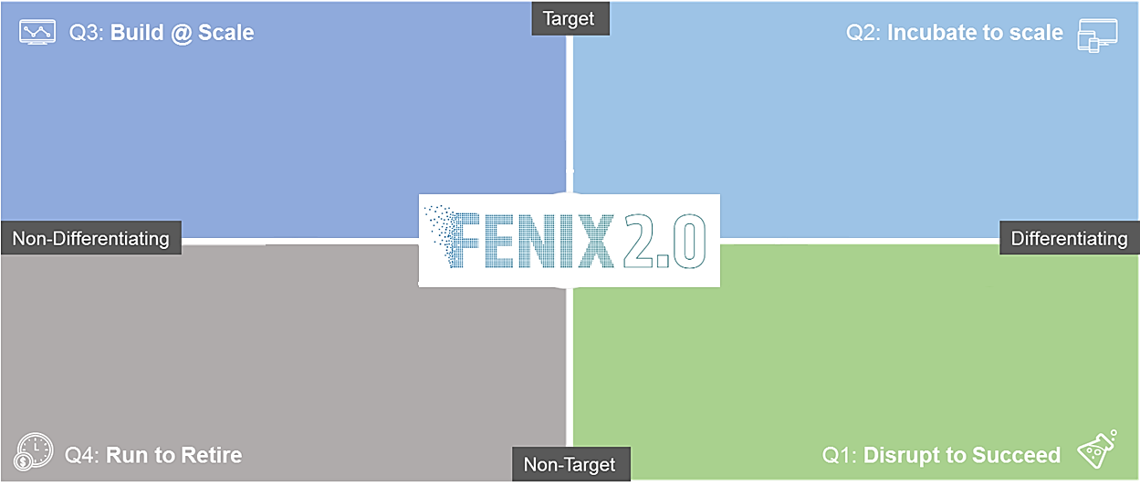
Alignment to FENIX 2.0
Intelligent Data Management – Data Management As A Service
Adaptive Data Platform – Transversal Data Platform on Cloud
Consumption based - Data Marketplace to commoditize Insights Delivery
Smart Data Operations – AI & ML in Automation of Data Ops – Data Classification, Data Orchestration, Data Testing & Deployment
Intelligent Data Management - Build data catalogs I Masters
Adaptive Data Platform - Newer Data Pipelines on Cloud / Appliances
Consumption based Analytics - Analytics Infusion & Next Gen BI
Smart Data Operations - DataOps
Data Content, Platform & Consumption Squads
Data Content & Consumption Squads
Platform Squad
Innovation Squad
Intelligent Data Management – Information Lifecycle Management
Adaptive Data Platform – Data Bots managing Data Platform
Consumption based – Modernizing Semantic Interfaces
Smart Data Operations - Kaizen / 5S in Data Ops
Adaptive Data Platform - Newer Design Patterns to Data Delivery
Consumption based Analytics - Insights Marketplace / New Use Cases

Slide 6
Thank You

