Slide 1
ADvantage Azure Data & AI
Overview in a Nutshell

Slide 2

About ADAz Data & AI Suite
ADAz Data & AI is a Suite is under HCL DNA’s proprietary ADvantage Azure umbrella consisting of Services, Capabilities and Solutions for Microsoft Azure based Data & AI Programs following Data First Philosophy and Data at Scale Approach. It includes Strategic Frameworks, Accelerators, Tools & Techniques, Scripts and Technical Capabilities.
Objectives / Goals of ADAz Data & AI guided Execution of Azure based Data & AI Programs in Large Enterprises
Faster Execution & Higher Productivity
In-Built Automation Scripts for various actions, Optimized route of Execution, available Reusable items and Ops Model deliver quicker implementation
Adherence to Best Practices through Standardization
Guided by Standardization from Microsoft Recommendations as well as Industry Benchmarks optimizes Approach, Architecture, Tools and Services for every ask
Reusable & Customizable Scripts / Tools / Frameworks
Bundle of Scripts, Tools, Frameworks to be used in various purpose of Azure Data & AI work towards immediate Readiness and pre-tested Customizable Components for easy reuse
Hybrid with 3rd Party to boost Microsoft Ecosystem
While MS Azure defines PaaS and SaaS for various Data & AI requirements, some 3rd Party tools from niche as well as large vendors performing better are leveraged along with home grown solutions to deliver better
Industry focused Avatars
Industry specific Use Case driven Reusable Packages (bundle of Data and AI components) readily available for usage for customers in specific Verticals

Slide 3
Service Portfolio
Service Areas
Managed Data Life Cycle Engineering
All kinds Data Operations across diverse Data Life Cycle stages utilizing Microsoft Azure Data Components
Data Transformation and Migration
Guided Migration & Transformation of Data from diverse On Premise and Cloud sources helping Consolidation
Data Governance and Advanced V&V
Governing Data Ecosystem end-to-end using Advanced DataOps, Data Quality, Data Test and overall Governance
Low Code Data and AI Ecosystem
Rapid Development of Apps, Process Flow, Dashboard and Virtual Assistant using MS Power Platform
Intelligent Business Conversation
Human-Machine Partnership through Intelligent Business Conversation delivering Digital Functions
Intelligent Voice Engineering
Omni-device Voice based machine assisted Digital Operations for B2E, B2B and B2C users
Service Tracks
Strategic Service
Strategic Advisory covering Business, Operational and Technical Advisory around Data & AI Ecosystem
Implementation & Maintenance Service
Includes all Design, Build, Test, Deploy, Monitor and Maintain work along Data and AI Life Cycle Stages
Transformational Service
Deals with Consolidation, Modernization, Automation, Advanced Use of Machine Intelligence

Slide 4
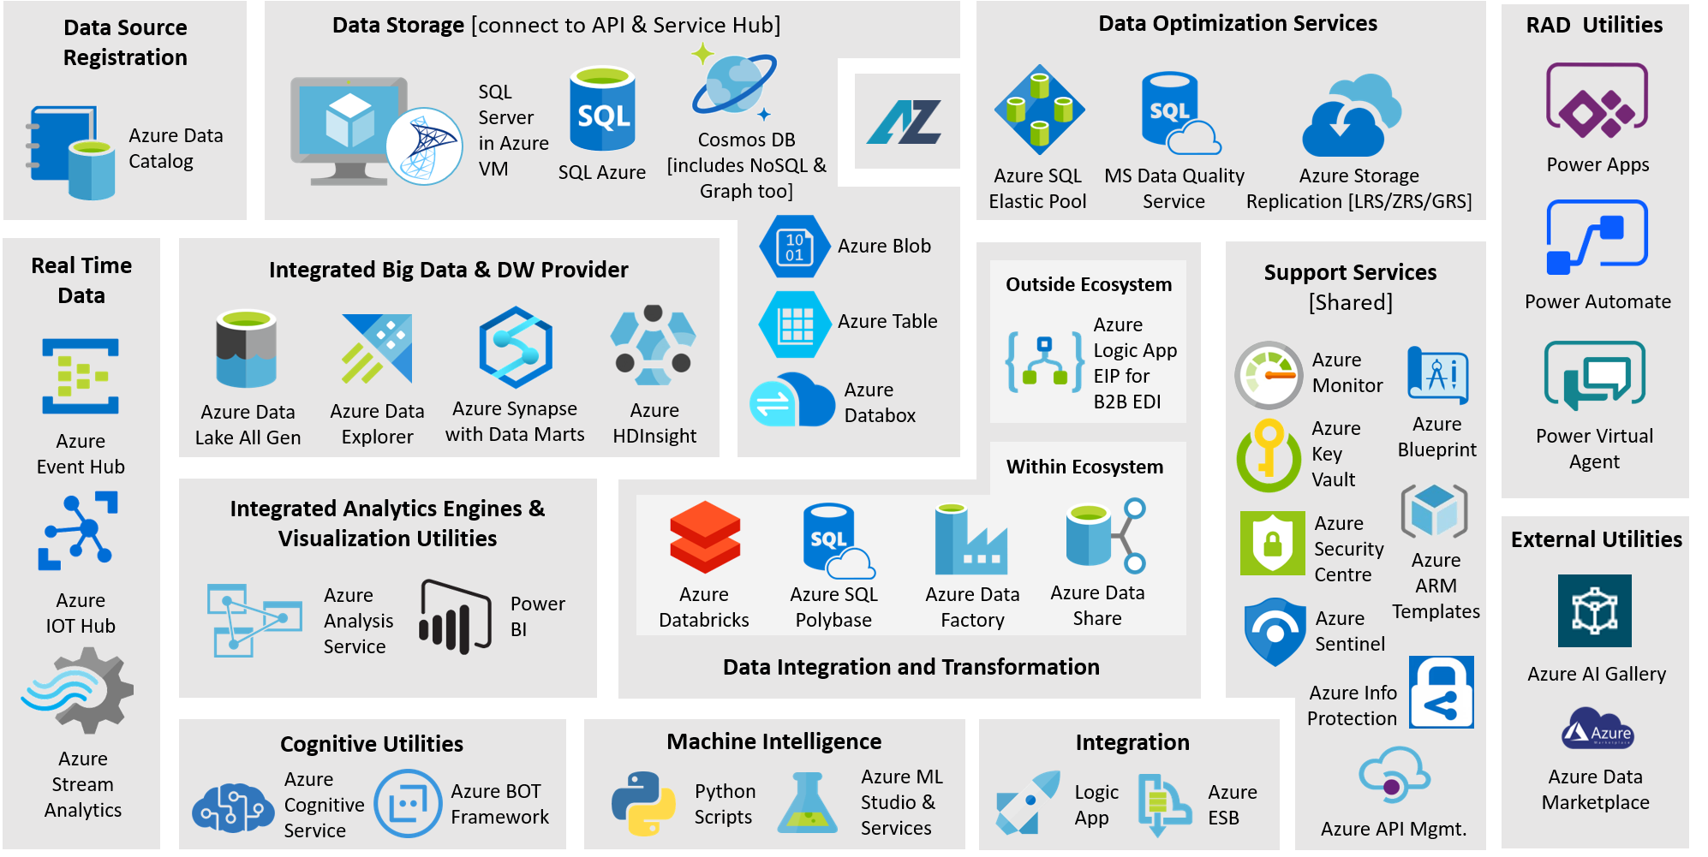
Technology Coverage

Slide 5
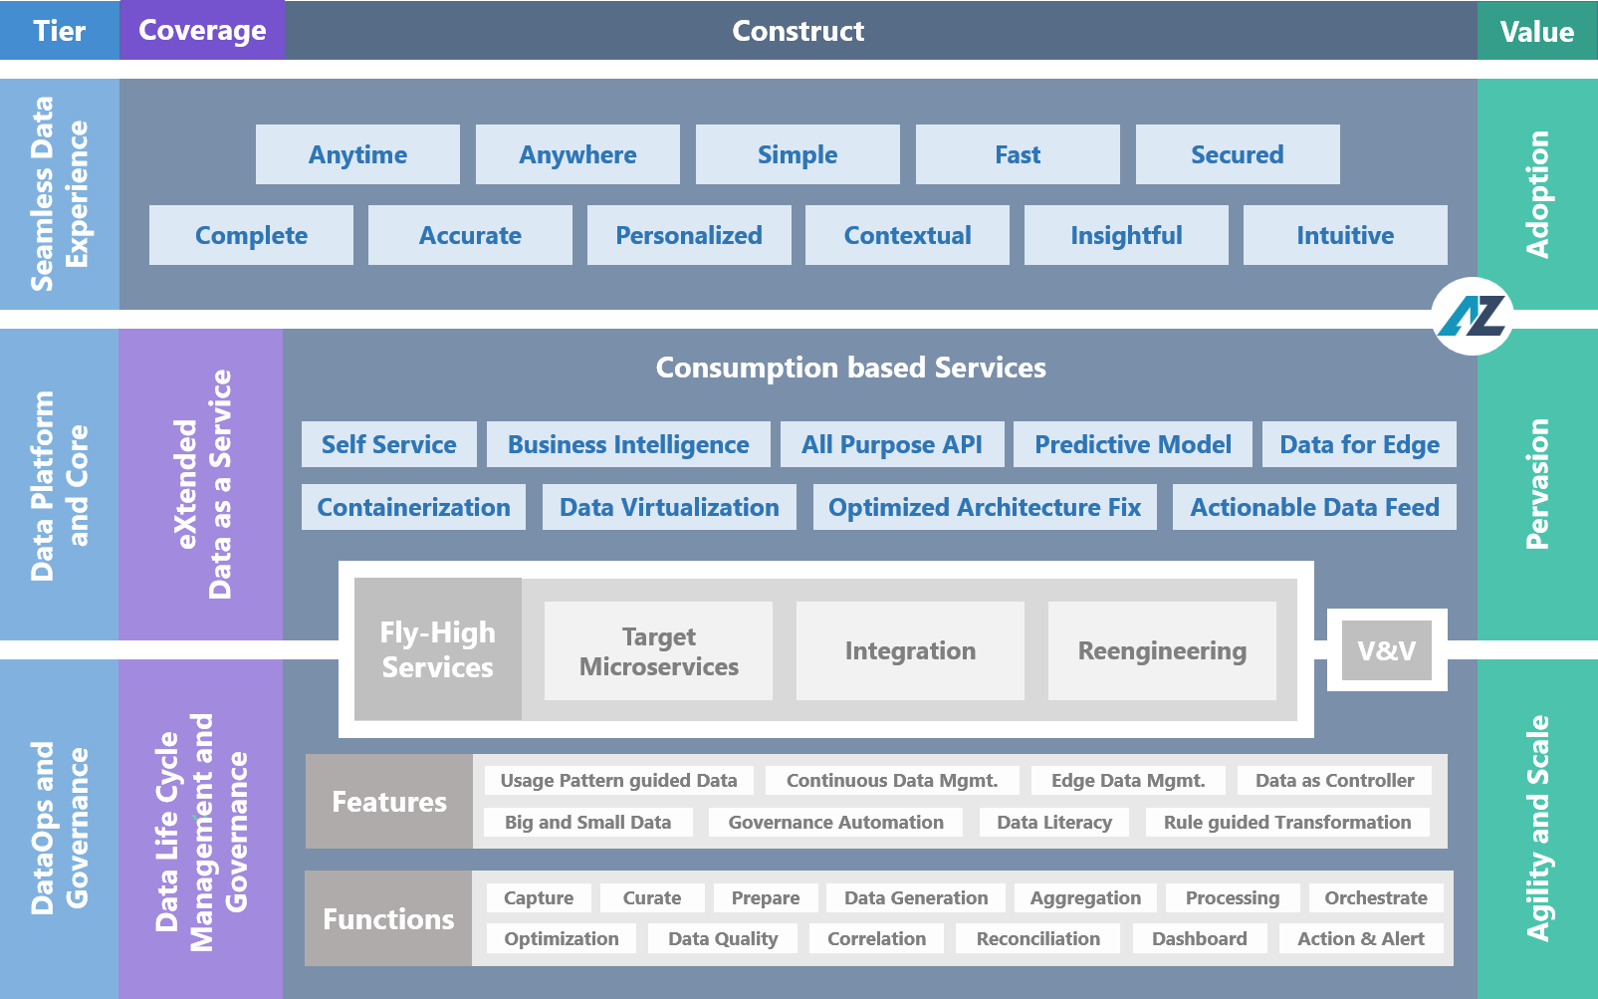
Data Construct

Slide 6
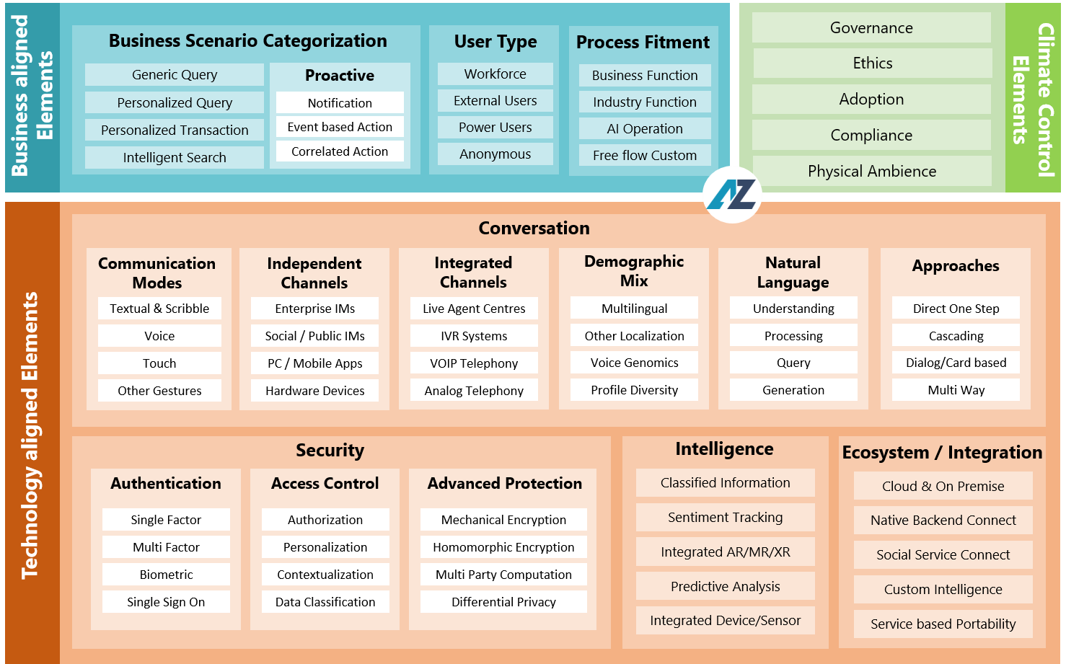
AI Construct

Slide 7
IPs and Accelerators
ADAz Sketch Fast Track Automation of Data Transformation Processes using Pre-built APIs, Connectors and Pipelines | ADAz DataOps End-to-End Data Governance and Operations for entire Life Cycle of Data | ADAz Gatekeeper Data Validation and Verification Solution for heterogeneous Data Platforms | ADAz DQ Data Quality Management Utility with Data monitoring, Governance and Management facility
ADAz Power BI Cockpit Template based Fast Track Development of Power BI Visualization as Factory Implementation | ADAz Pipeline Factory Pre-built Configurable Azure Data Factory Pipelines ready for Reuse in Data Ecosystem | ADAz Migration Booster Single point Framework to Manage Data Migration from On-Premise, Cloud to Azure Stores | ADAz iSee Holistic Intelligent Monitoring Platform covering Servers, Services and Applications
ADAz Meta Wisdom Automation Solution targeting Advanced Data Lineage for Enterprises | ADAz Data Marketplace Having Data available as a Catalog with Metadata based Subscription facility | ADAz ADF Cockpit Template based Fast Track Development of Azure Data Factory as quicker Data Transformation | ADAz PerisKop End-to-End Fast Track Intelligent Enterprise Search Solution Builder
ADAz Intelligent Assistant Human-Machine partnership through Intelligent Business Conversation across Domain Digital Functions | ADAz Model Manager Python based Enterprise scale ML Modeler to manage Data Science Lifecycle | ADAz CALM Conversational Assistant for data-infused Application Lifecycle Management | ADAz VoiceNet Voice based Machine Intelligence, Voice Operations, Voice Biometrics and Analytical Outputs
ADAz SmartBuy Machine Intelligence guided Informed Procurement and Supply Chain Decision Maker | ADAz ORQi Persona driven Hybrid Integration Platform for Controlled, Secured and Automated Data Access | ADAz Service360 Service Automation utility covering end-to-end Capabilities and Offerings | ADAz HiPerform Intelligent Performance Management Solution connecting Strategic, Financial and Operational Dots
Data IP / Accelerator
AI IP / Accelerator

Slide 8
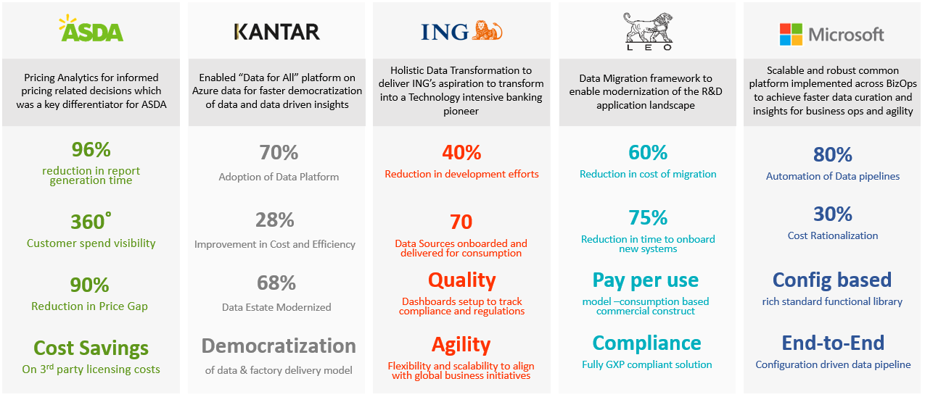
Top Value Delivery to Large Enterprises

Slide 9


Practice Snapshot
Experience Snapshots in Client Enterprises
⁷⁵⁰⁺
60+
Credit Risk Analytics helped with 66% cost reduction in predictive credit risk modeling for a financial services Company
Helped in reducing data integration cost by 68% through technology landscape simplification
Call Centre Analytics helped with 25% call volume & 10% call handling time reduction for a major Irish Bank
NLP & ML based Solution achieved 91% accuracy to assign service tickets for World’s Largest Furniture Manufacturer
ML driven automation led to 20% effort reduction per day per Buyer on purchases for a Global CPG Company
Built intelligent design thinking led Data Management capability and FENIX approach resulting in 35% cost rationalization
Setup Big Data COE and processed 20+TB data and reinvested 2% of revenue for co-innovation
Improved operational agility by 36% with implementation of data pipeline for a leading aircraft manufacturer​
Harmonized coding system was used to achieve 94-97% success rate in predicting caging probability for international shipments
Built data and MDM solution to achieve over 25% increase in revenue generation through upsell/cross sell
Built next-gen, unified data platform to provide business insights with 50% reduction in effort for a leading pharma company
Built next-gen Integrated Data Lake in an accelerated timeframe to improve efficiencies by 36% and provide NBA/NBO insights
Built Data story telling based reporting solution giving 1.5x improvement in ROI and 23% cost save
Modernized data foundation toward real time decision making for pricing / advertising functions with 90% reduction in insights
Azure Data & AI Subject Matter Experts
Overall Global Customers
20+
150+
Unique IPs and Accelerators
Similar Data Program Experience
Analyst POV
Rated as a Leader in inaugural Marketscape on Cloud Business Analytics services
No. 1 player @ Forrester Wave for Specialized Insights services

Slide 10
Thank You

