Slide 1
ADvantage Azure
Intelligent Assistant
A Detailed Walkthrough

Slide 2
Contents
Context
Overview
Conceptual
Deep Dive
Technical
Services
Operations
Success Stories

Slide 3
Context

Slide 4
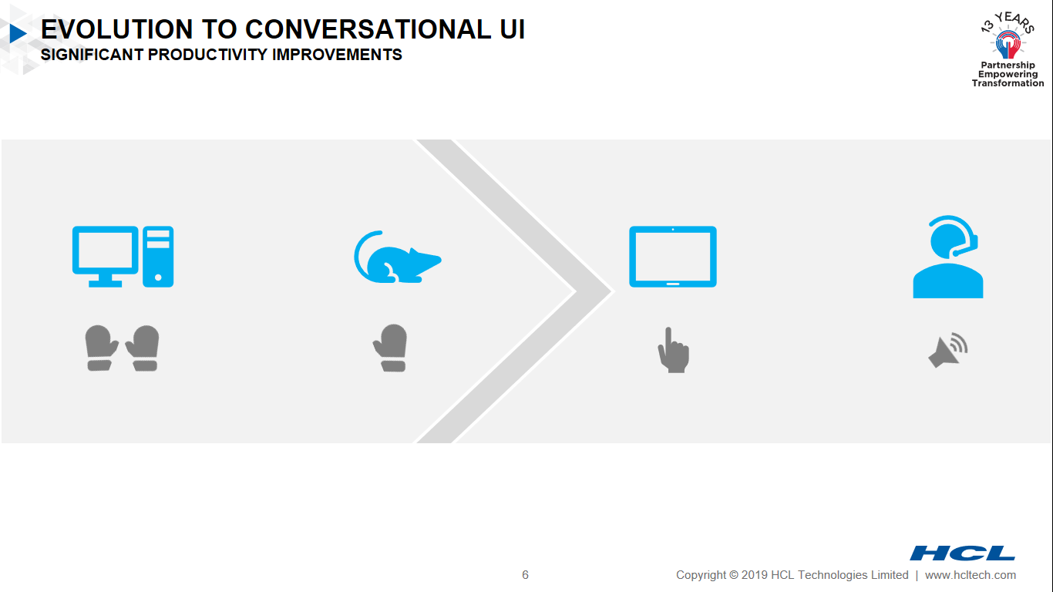
Usage Pattern Evolution
How User Behaviour has been changing for Business Communications

Slide 5
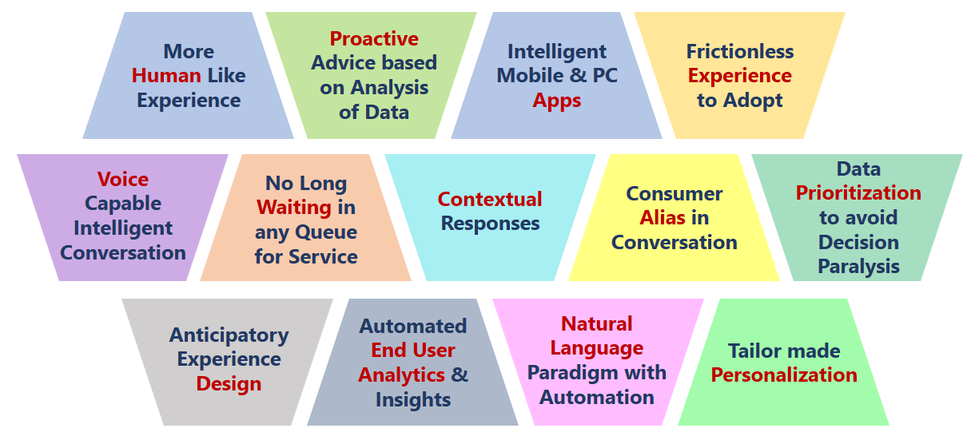
Challenges and Wish List
Pains and Needs Users / Enterprises facing leading to Intelligent Conversations

Slide 6
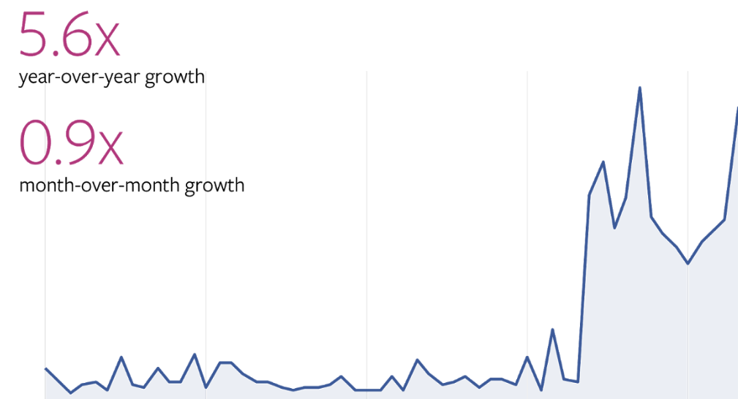
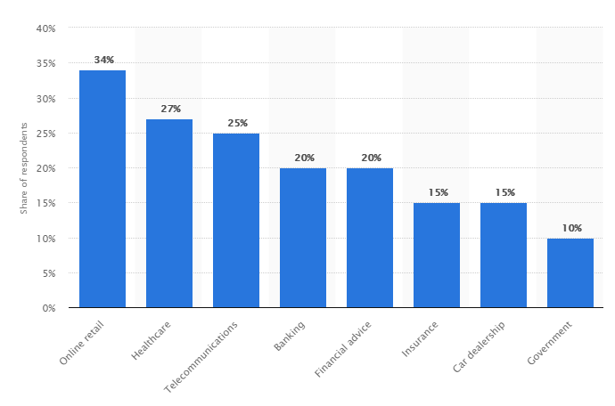
Market Trends
How Business wants to adopt Intelligent Conversation Interfaces
1 of 2
Global Trend of CUI Usage over 2017-18
Industry wide CUI Usage Swing
Source Facebook IQ, Statista

Slide 7
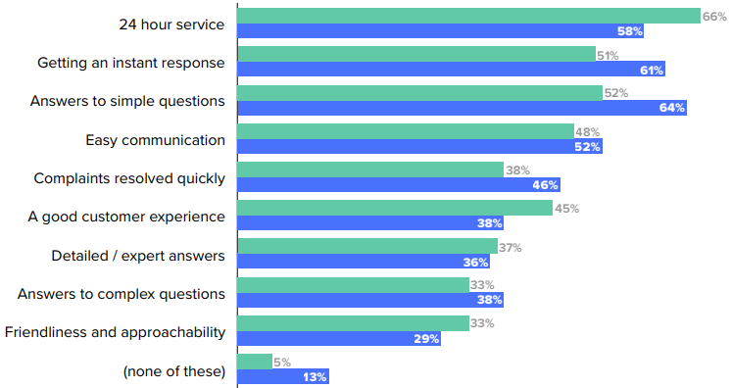
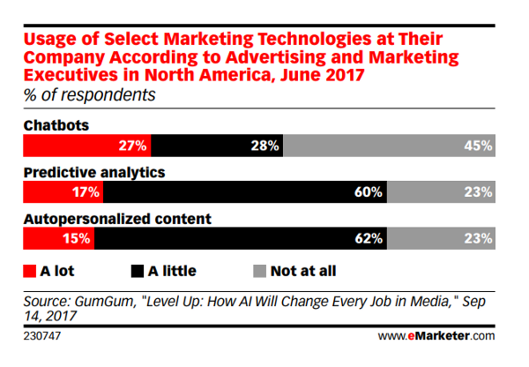
Market Trends
How Business wants to adopt Intelligent Conversation Interfaces
2 of 2
CUI Adoption across User Generations
User Choice Trend for CUI & Allied Technologies
Source Drift Analysis, e-Marketer

Slide 8
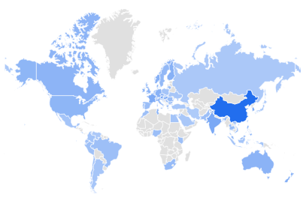
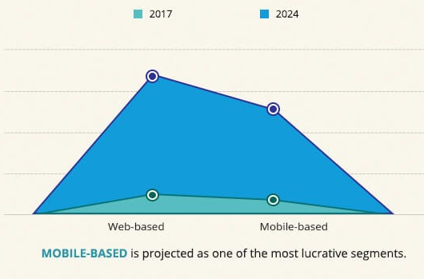
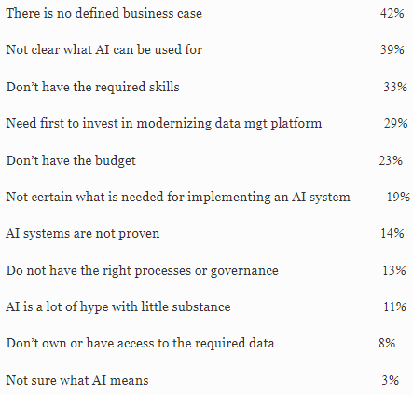
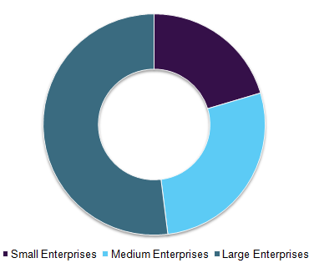
Analyst View
Point of View on Intelligent Business Conversations by Top Analysts
Top CUI Trends
Global CUI Market by Geography
Global CUI Market by Client Device
Global Chatbot Market is expected to exceed a growth rate of CAGR of more than 27%, in BFSI itself CUI market is projected to reach at OS$2,186 million by 2024, growing at a CAGR of 29.7% from 2018 to 2024
By 2020 25% of all customer service interactions will be completely handled by AI powered CUI, an increase of 600% from 2017
By 2021, early adopter brands that redesign their websites to support visual and voice search will increase digital commerce revenue by 30%
Rule-based CUI owns around 85% of the market but their acceptance rate is anticipated to reduce over the forecast timeline, while AI-based chatbots are growing at a CAGR of 53%
Worldwide Spending on Cognitive and Artificial Intelligence Systems Forecast to Reach $77.6 Billion in 2022
South East Asia is the Highest growing Region
Top Obstacles to CUI Journey
as experienced by various enterprises
CUI Interest by Enterprise Profile
Source Forbes, Google Trends, Market Watch, Allied Market Research, Gartner, GM Insights, Grand View Research, Forrester, IDC

Slide 9
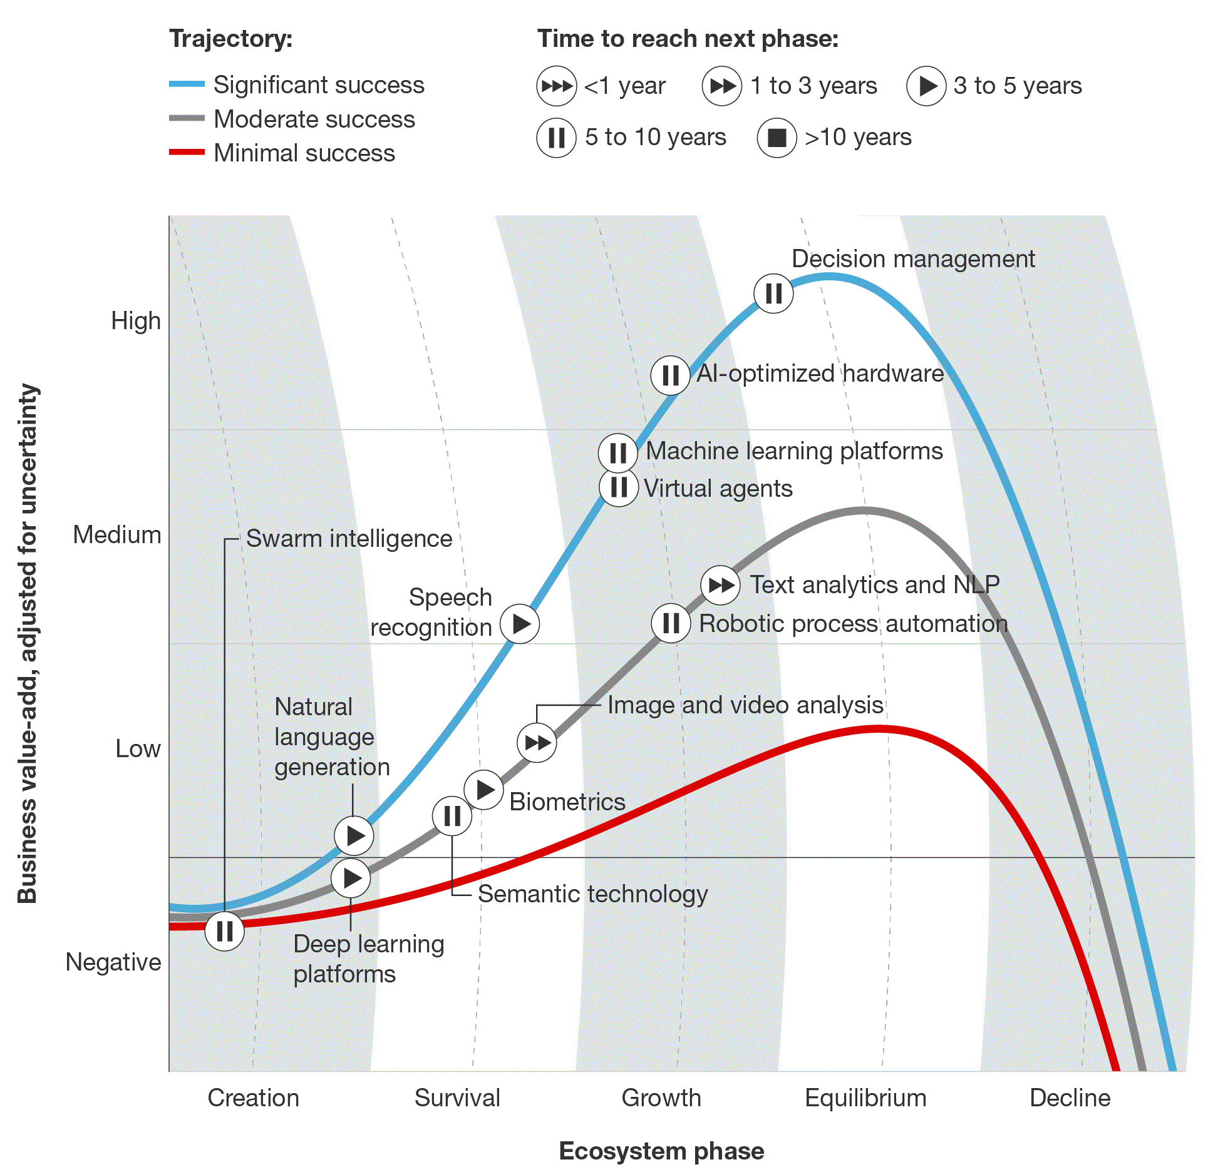
Technology Trends
How Technology Providers operating in Intelligent CUI space
1 of 2
Top CUI Vendors positioning in Market
Maturity Trajectory of AI Technology around CUI Program
There are over 100,000 chatbots just on Facebook Messenger alone
Microsoft has announced that it’s seen a 350% yearly increase of monthly active users to about 0.7 million users on its Cortana digital assistant
Amazon’s well on track to sell up to 60 million Alexa devices by 2020
Top Selling Use Cases & their Potentials
Automated Customer Service Agents ($2.9 billion)
Automated Threat Intelligence and Prevention Systems ($1.9 billion)
Sales Process Recommendation and Automation ($1.7 billion)
Automated Preventive Maintenance ($1.7 billion)
Source Gartner, Forrester, IDC

Slide 10
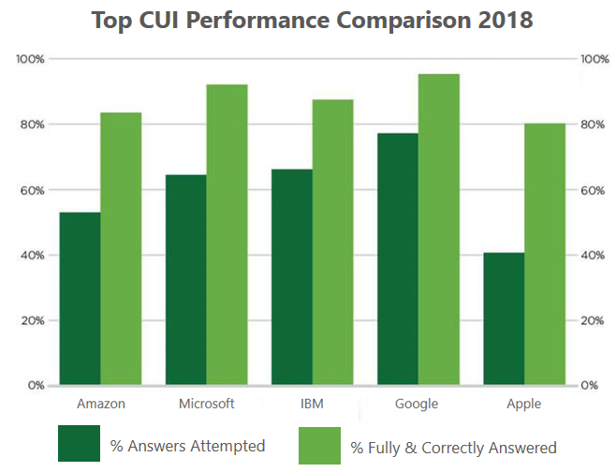
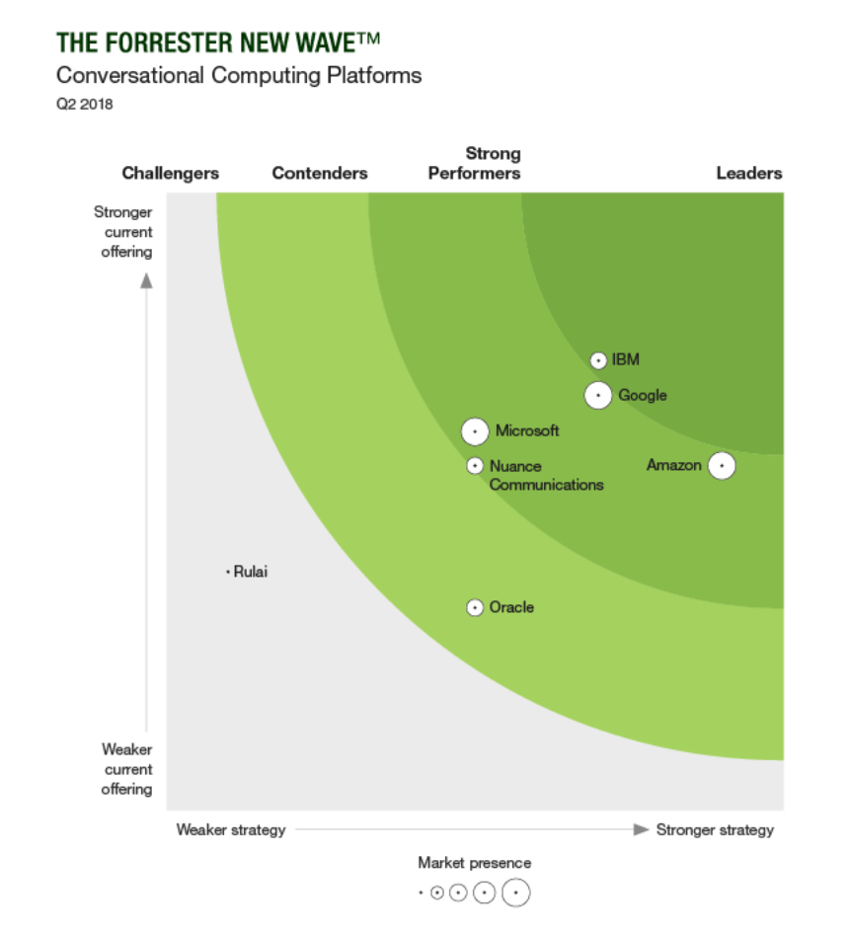
Technology Trends
How Technology Providers operating in Intelligent CUI space
2 of 2
Top CUI Performance Comparison 2018
Conversational Computing Platforms [Q2 2018]
Source Forbes, Forrester

Slide 11
Overview

Slide 12


What is
ADvantage Azure Intelligent Assistant is a Manifestation of Human-Machine Partnership through Intelligent Business Conversation for diverse queries and reactive / proactive Actions on various Industry specific Digital Functions

Slide 13
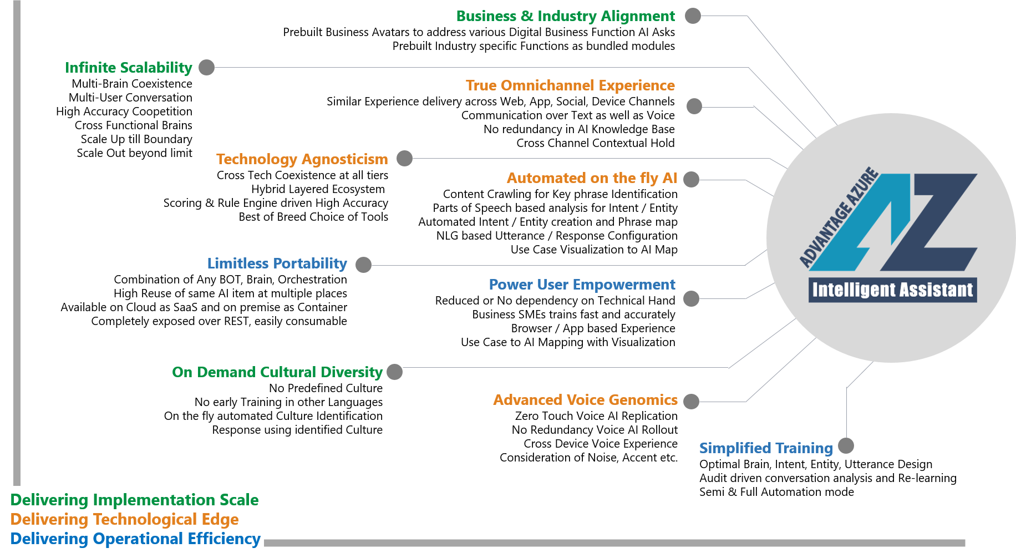
Uniqueness Unleased
The Unique Perspectives absent in Competition

Slide 14
Critical Success Factors
What can ensure the Success of ADAz.IA Implementation
Appropriate Selection of Candidate Use Case
Optimal Design of Intelligent Elements
Choice of Appropriate Channel
Rigorous but Controlled Training
Response Alignment to target Human Dialects
Staggered MVP Planning
High Degree of Automation
Pro-action and Prediction

Slide 15
Value Delivery
How ADAz.IA addressing the Pains and Needs of Enterprises
Faster Processes to improved User Satisfaction Index
Increased Productivity to Quicker GTM Cycle
Simplified Processes & Functions to Enhanced Effectiveness
Reduced Human Dependency to Higher Accuracy
Reduced Expense in Complex Operations
Analyzed History Data to Upfront Troubleshooting
Correlated Event Analysis for Proactive Preventions
Anytime Anywhere Access to Higher Adoption

Slide 16
Deep Dive
Conceptual

Slide 17
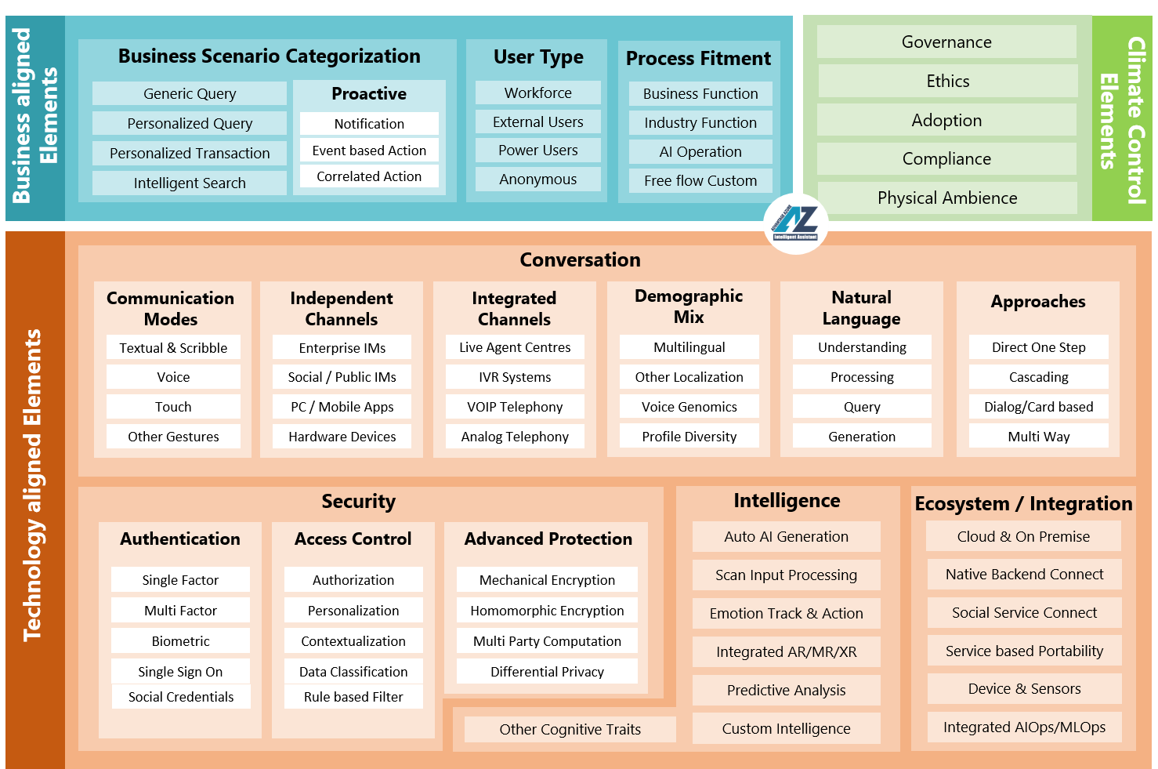
Reference Architecture
Conceptual Building Blocks of the Platform

Slide 18
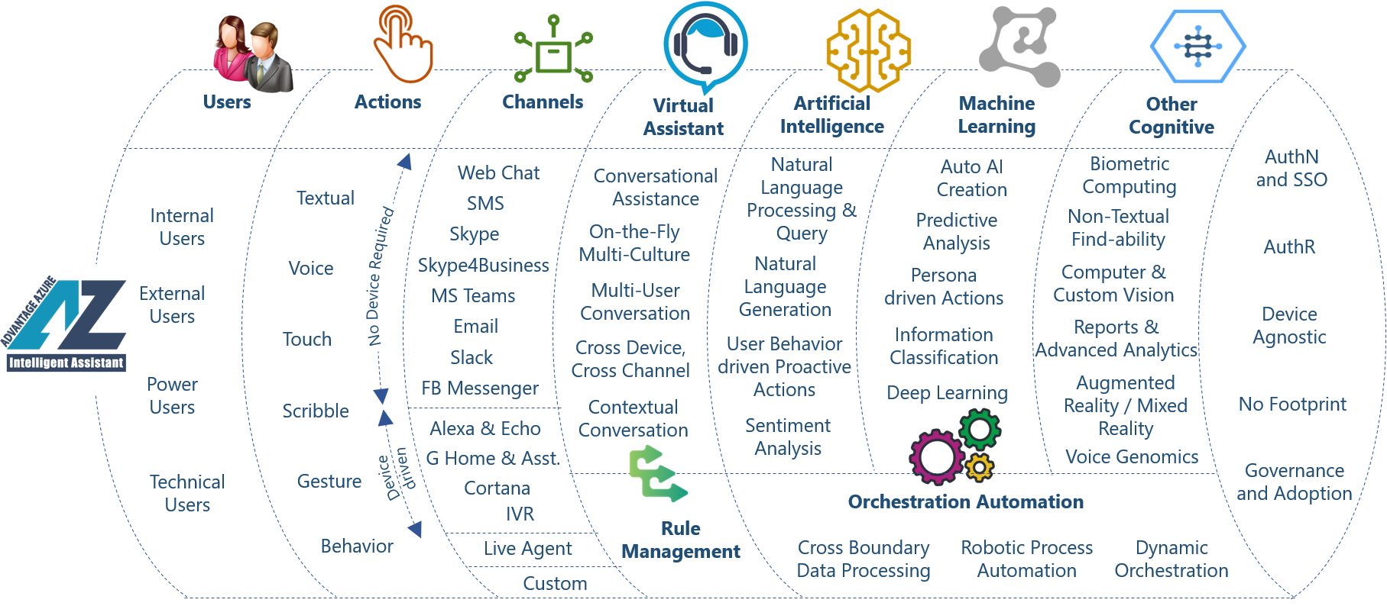
Core Construct
Techno Functional Platform Constituents

Slide 19
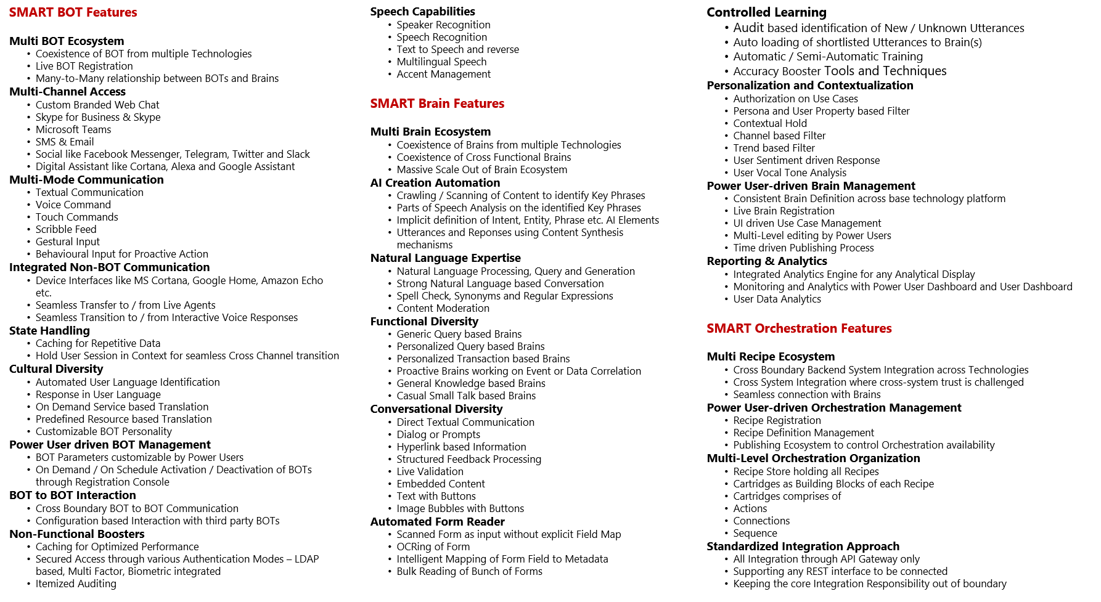
Feature List
List of Features and Functions included

Slide 20
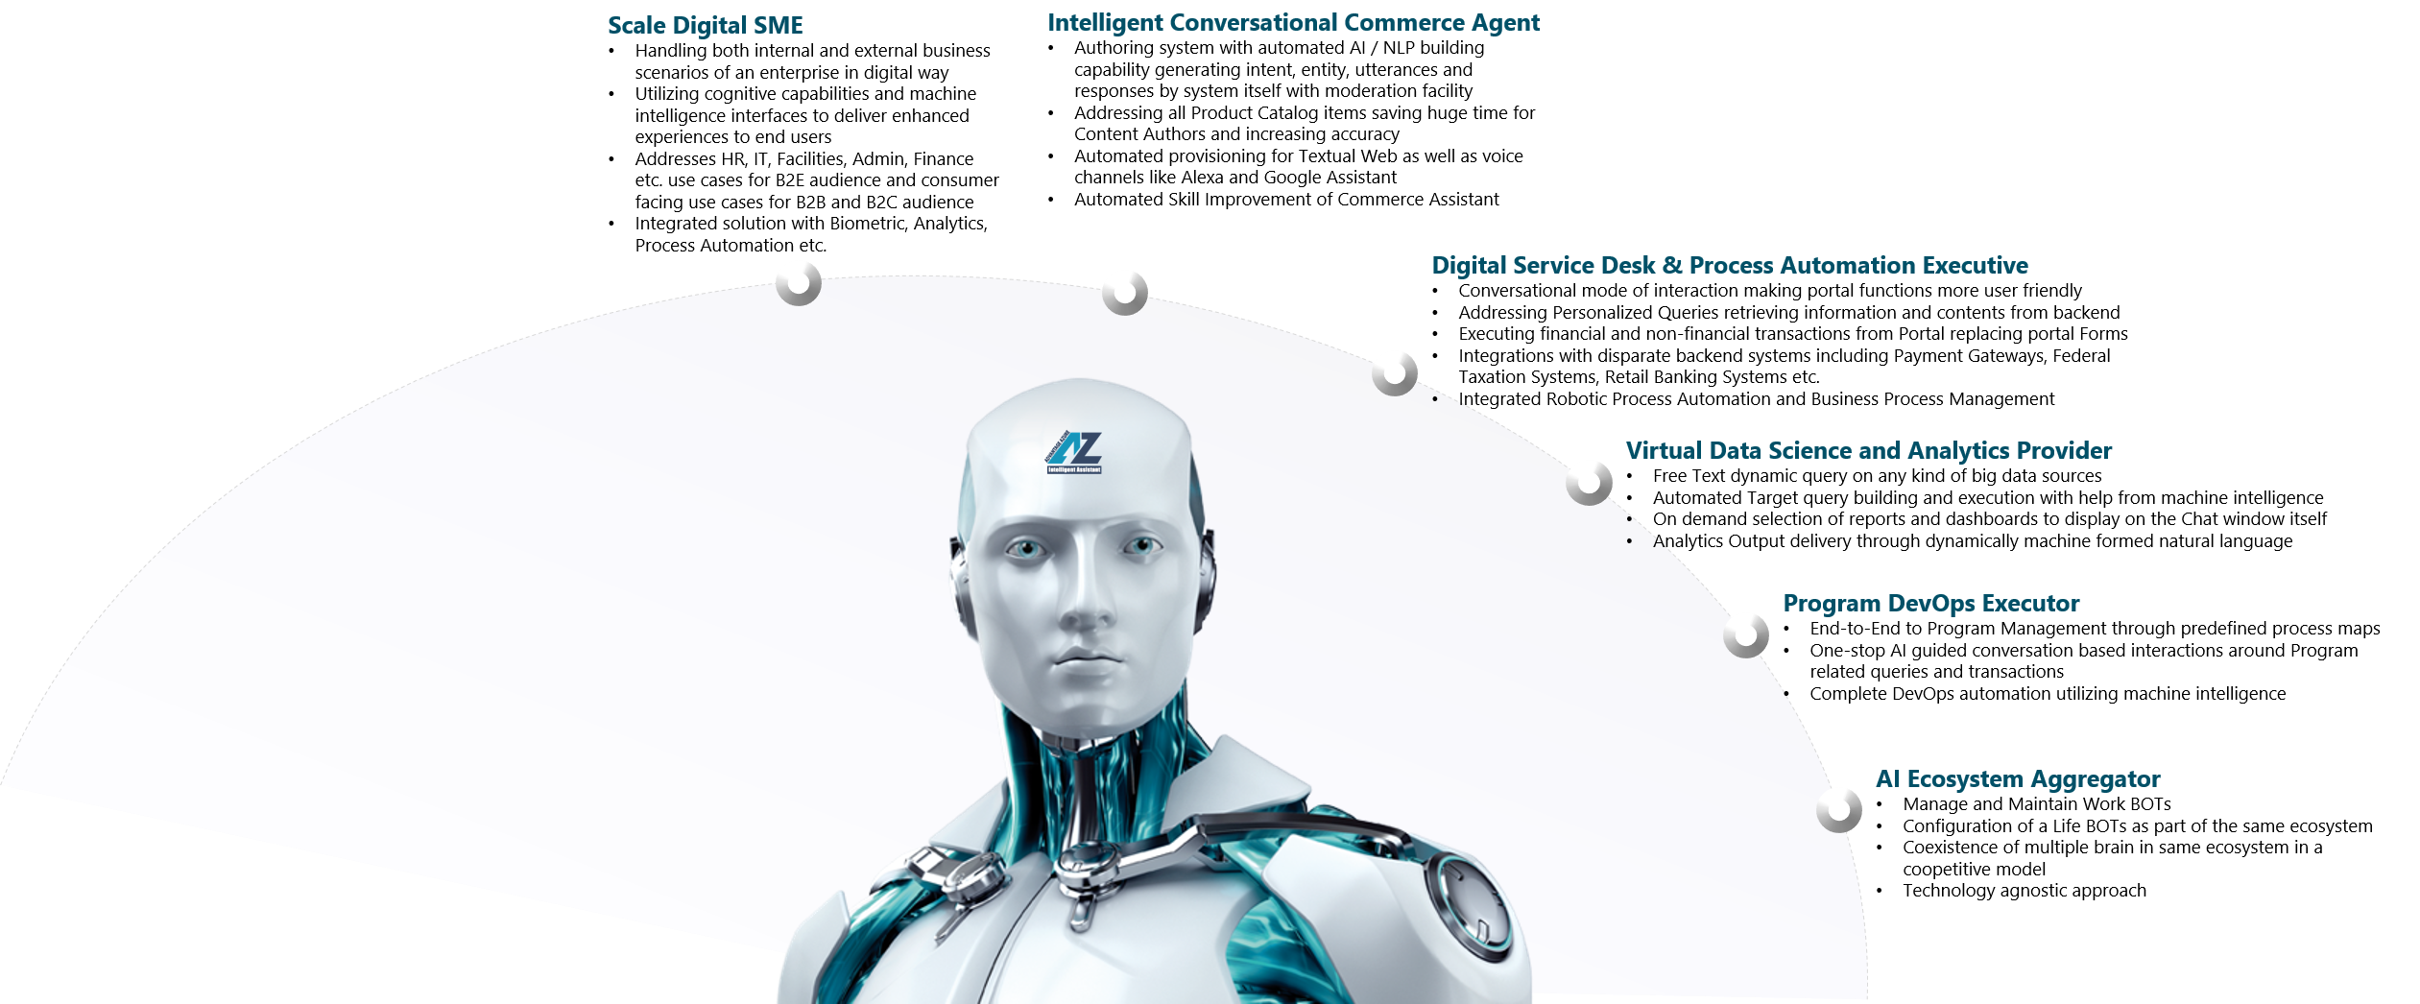
Business Avatars
Pre-built Full Functional Industry agnostic Intelligent Business Utilities

Slide 21
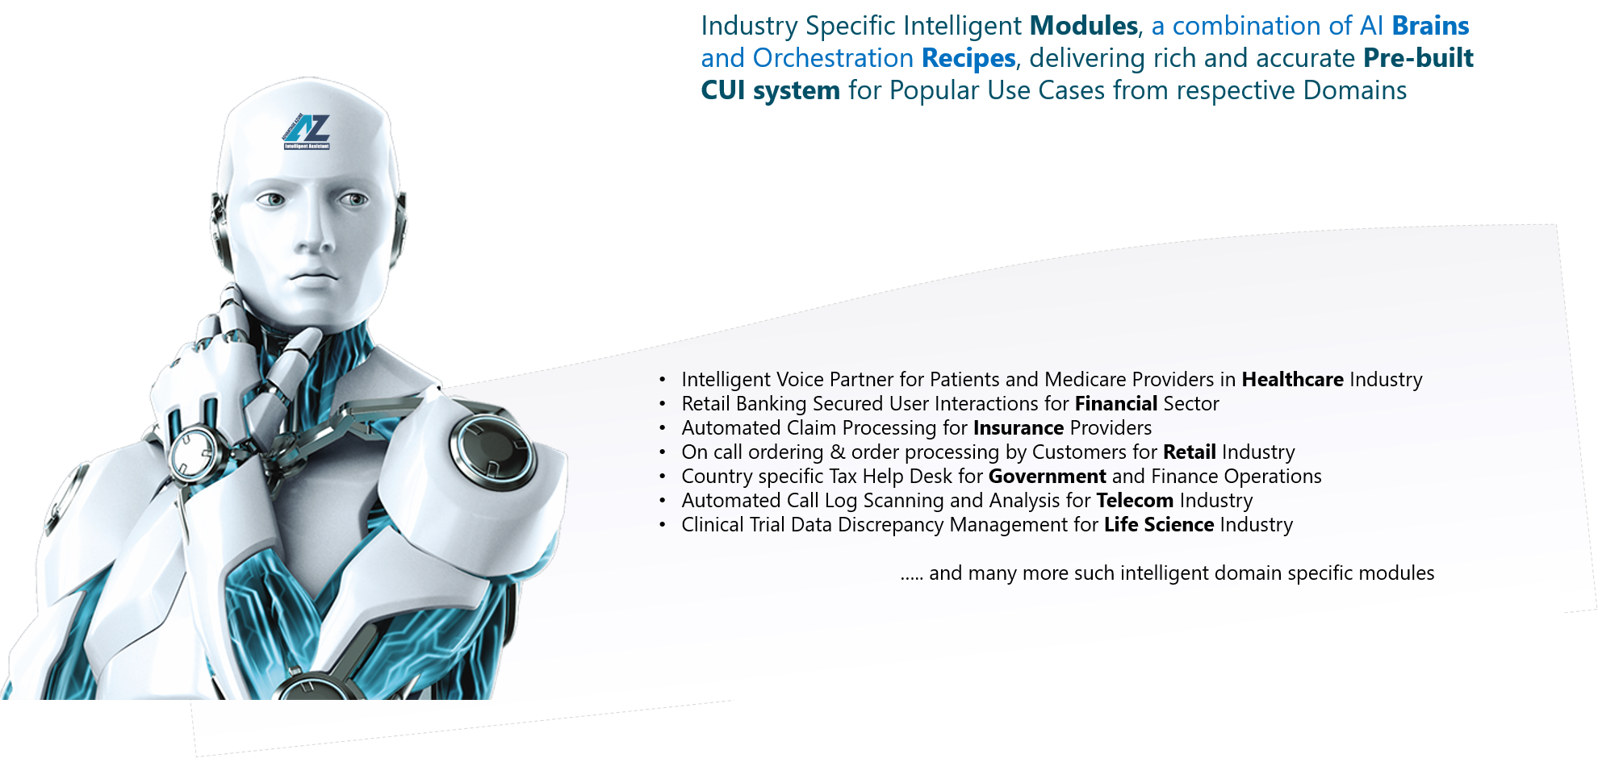
Industry Avatars
Pre-built Reusable Industry specific Intelligence Factory

Slide 22
Deep Dive
Technical

Slide 23
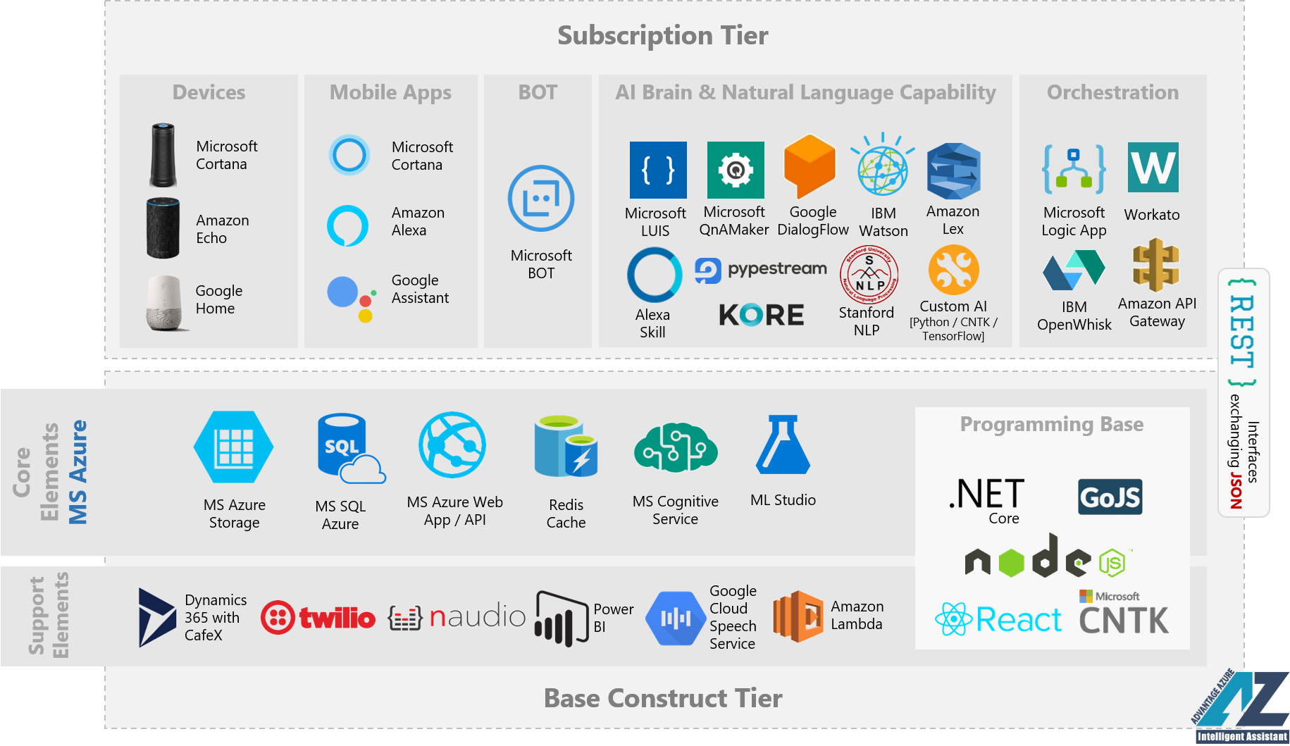
Technology Touchpoints
Assembly of Technology Elements for overall Build

Slide 24
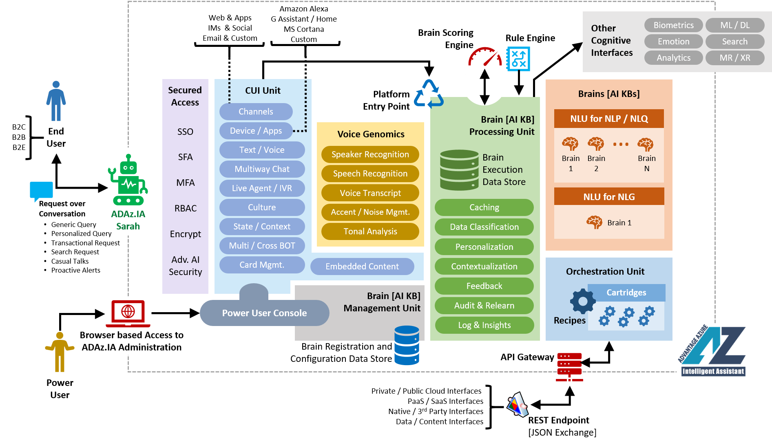
Technical Architecture
Interwoven Organization of various Technical Component

Slide 25
Services

Slide 26
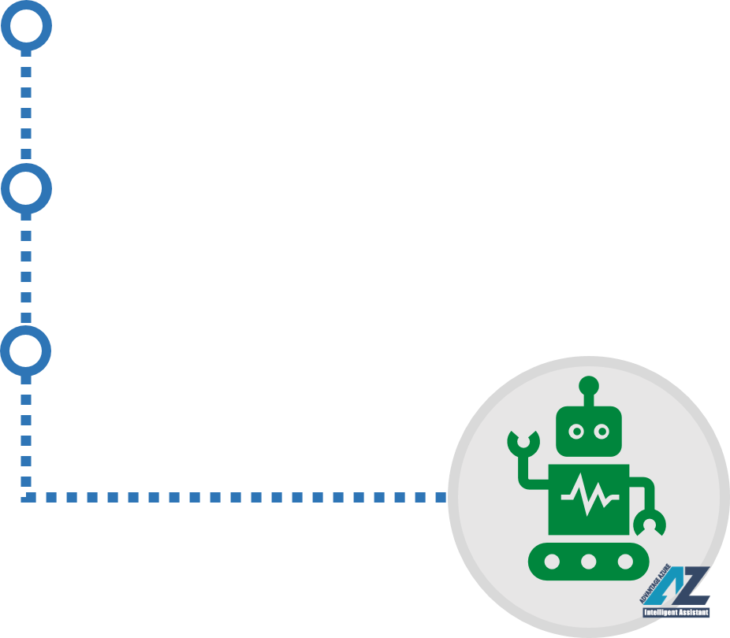
Service Portfolio
Service Tracks offered under ADAz.IA Umbrella
Advisory Services
ADAz.IA driven Intelligent Business Conversation Ecosystem Implementation actions are categorized across various Service Buckets for optimal and fast availability of the service components served by right subject matter experts in that area.
Ideally these service components in the portfolio have an ideal sequence of execution. However, that can be customized to acceptable extent based on the enterprise needs.
All these Service Components are Optional i.e. enterprise can pick any or all of these based on their need.
A Strategic Guidance Plan & Design Enterprise Program around Intelligent Business Conversation
Implementation Services
Phased Optimal Execution of Intelligence Business Conversation Ecosystem
Support Services
Ongoing Execution of Troubleshooting and Continuous Improvement Needs

Slide 27
Operations

Slide 28
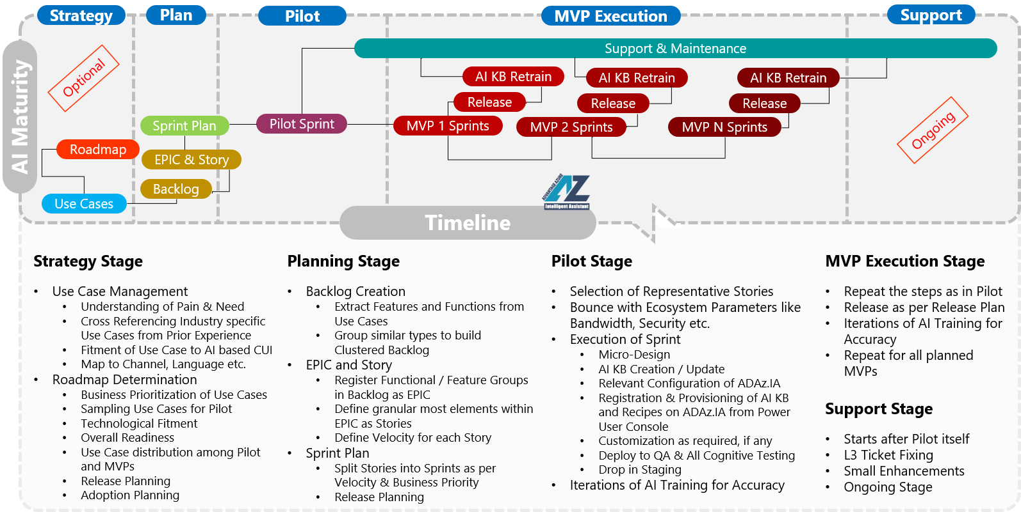
Program Execution Model
Typical Approach followed in ADAz.IA based Implementation

Slide 29
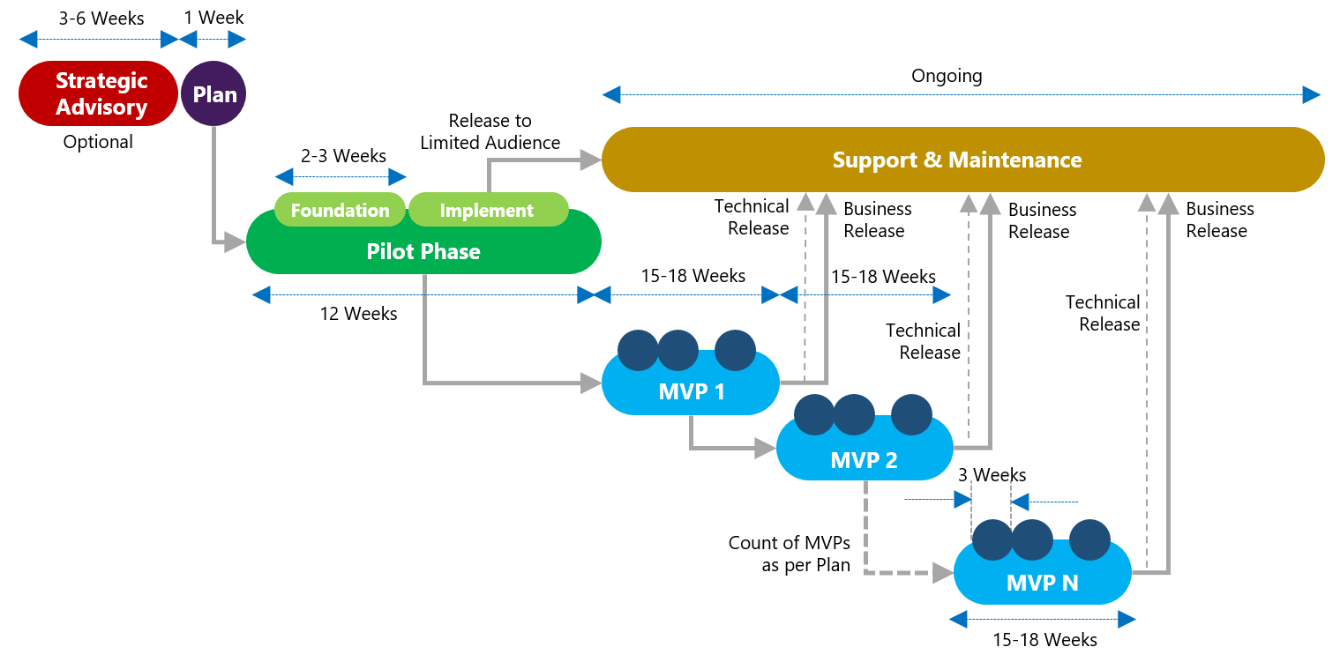
Program Timeframe View
Typical Timeframe Guidance for Execution of ADAz.IA based Implementation

Slide 30
Implementation Pre-requisites
Expected elements of Hardware, Software, Services etc. from Enterprise for Rollout
Business & Operational Readiness
Technological Readiness
Identification of Key Stakeholders who can provide the Use Cases to take to Intelligent CUI System
Getting the Intelligent CUI Ecosystem Roadmap defined based on Business Priority of the identified Use Cases, if not defined HCL can help during the initial Due Diligence
Availability of Program SPOC from Identified Stakeholders from Customer side during entire Program
Enabling Access to HCL’s ADAz.IA Team to necessary Cloud Resources like Destination Resource Groups, Full Control Service Account in LDAP etc.
Arrangement of at least one Azure Cloud Subscription available with relevant PaaS elements (Storage, AI, ML, CUI, Database, Web Publisher for Site-Service-Job, ) activated, in case of different technology alignment which are also supported by ADAz.IA this has to be applicable for respective Cloud (e.g. AWS, Bluemix, Google etc.) Subscription
All the Backend system with which the Integration is required from Intelligent CUI system (e.g. ERP, CRM, Databases, Big Data and Analytics interfaces, Content Repositories etc.) should be available with REST based interface exchanging information / data / content over JSON format

Slide 31
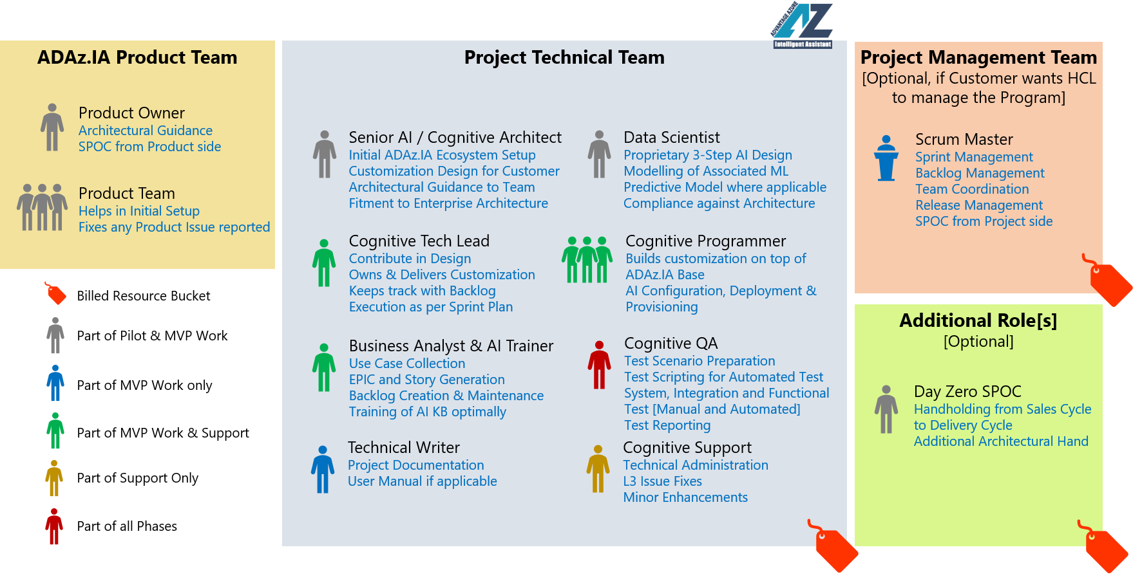
ADAz.IA Team Roles & Responsibilities
Typical Role & Responsibility Definition for HCL SMEs in Implementation

Slide 32
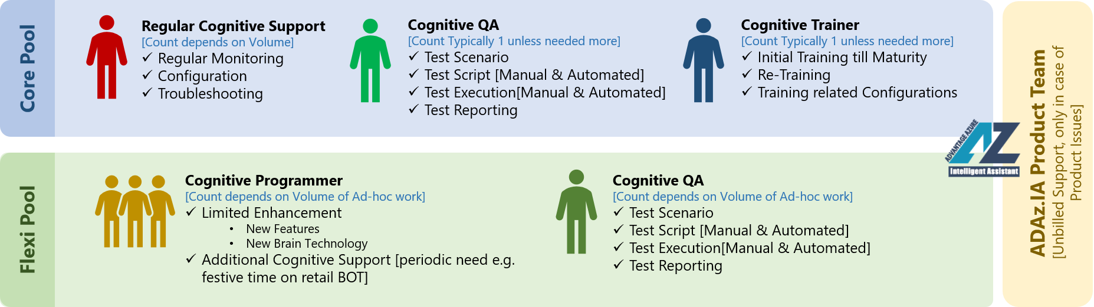
ADAz.IA Ongoing Support Dynamics
Typical Post Production Engagement Model

Slide 33
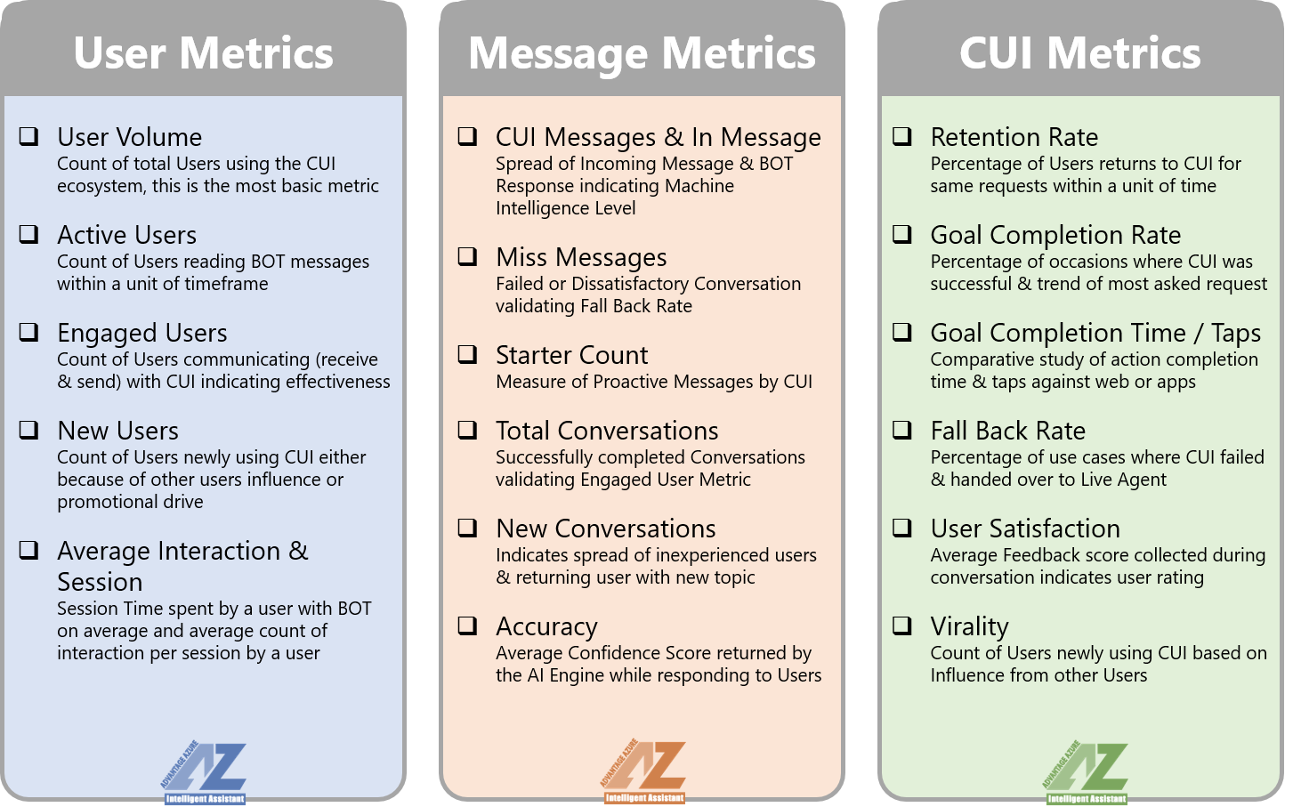
Platform Performance Metrics
Performance of ADAz.IA as a Platform in terms of quantitative parameters

Slide 34



Program Pricing Approach
How ADAz.IA based Implementation is Priced
Execution Stages
Strategic Advisory | Pilot Stage | MVP Execution | Support
Platform Price
Not Applicable | Perpetual Price of US$ 40K for ADAz.IA Foundation Executables [no codebase] as per DNA Catalog subject to revision case to case basis |  | No OPEX for ADAz.IA
Service Price
Time & Material basis depending on the Duration planned and Resource deployed as required for the Advisory Scope | Fixed Price basis as estimated based on Features spread and Use Case Complexity Level | Option 1 Fixed Price basis as estimated based on Features spread and Use Case Complexity Level Option 2 Outcome driven Price basis where definition of Outcome is defined during contractual agreement between HCL and customer | Time & Material basis depending on Core and Flexi Loading planned for the scoped Support and Maintenance Activities
Time & Material Model
Pricing is done based on agreed upon Rate Card which contains hourly / daily rates in respective currency for the Roles required for the exercise
Fixed Price Model
Pricing is done based on Effort estimated for the entire exercise calculated through proven estimation techniques based on various parameters
Outcome driven Model
Pricing is done based on Outcome of the exercise which is running on Production, outcome includes no. of transaction, no. of successful use case execution based on agreed upon terms & conditions

Slide 35
Environmental OPEX Projection
Minimum Running Cost on Cloud PaaS
Cloud PaaS | Mapped ADAz.IA Component | Minimal Cloud Service Plan | Expense
 |  |  | IN₹ | US$
Azure App Services | Platform BOT | Shared | 290 / month | 4.22 / month
 | Platform Core Web API | Shared | 290 / month | 4.22 / month
 | Platform Hosting Web | Shared | 290 / month | 4.22 / month
 | Power Admin Portal | Shared | 290 / month | 4.22 / month
Azure Storage | Storage Account Classic | Shared | 420 / month | 6.11 / month
SQL Azure | Platform Database | Basic | 330 / month | 4.8 / month
Redis Cache | Platform Cache | Basic [250 MB] | 1082 / month | 15.73 / month
Azure Cognitive Service | AI Engine – LUIS | Standard S0 | 100 / month | 1.45 / month
 | AI Engine – QnAMaker | Standard S0 | 661 / month | 9.61 / month
 | Azure Search | Standard S0 | 383 / month | 5.57 / month
 | Azure Text Analytics | Standard S0 | 661 / month | 9.61 / month
Logic App | Integration Gateway and Recipes | NA | 27 / use hour | 0.42 / use hour
~ US$ 372 / Instance
Note – Cost Projection shown is for Microsoft Stack based solution, for other stacks like Amazon, Google or IBM this can deduced on demand basis

Slide 36
Success Stories

Slide 37
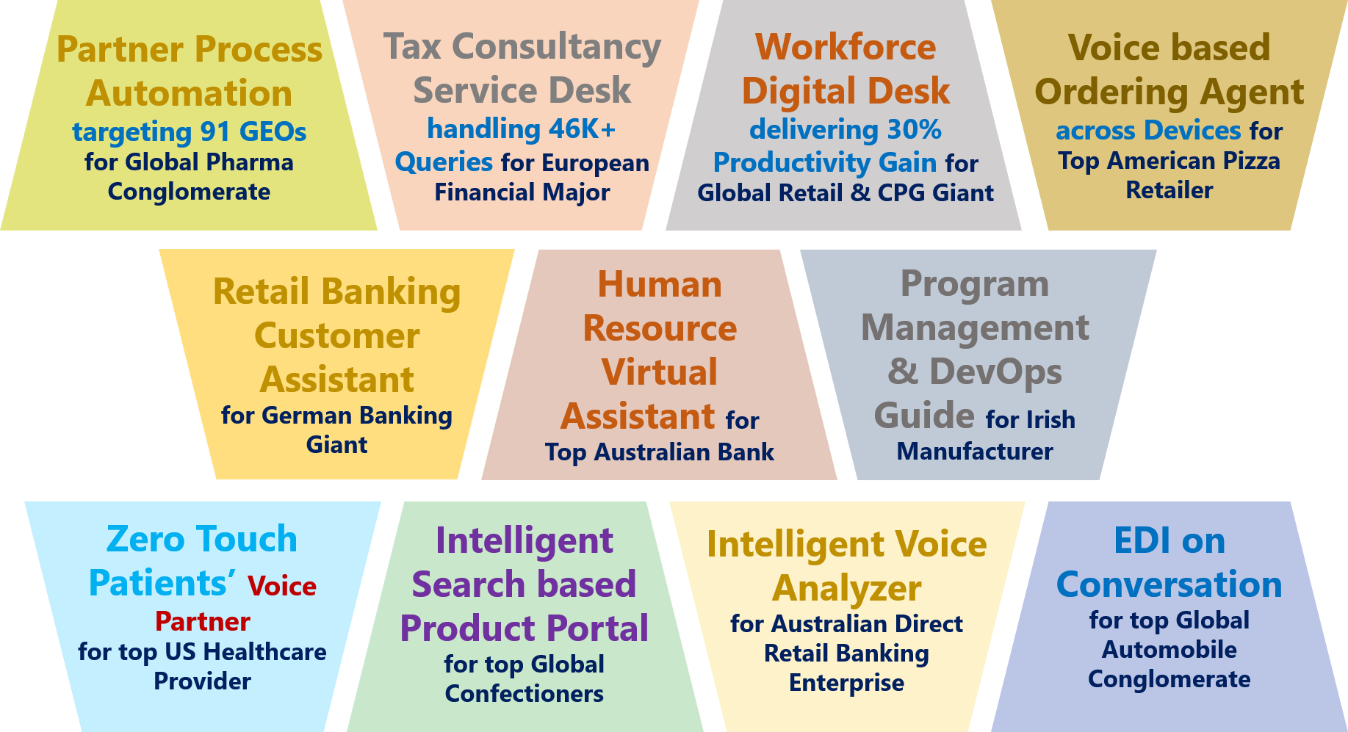
Top Experiences

Slide 38
Thank You

